Slide 1

WHERE COLLEGE LIFE MEETS CONVENIENCE!

Slide 2
MINI PROJECT GROUP 14 :- S5 CSBS 2021-2025
CAMBUZZ
STUDENT LIFESTYLE MANAGEMENT
PROJECT GUIDE
Ancy C A
Assistant Professor
Department of IT
RSET
GROUP MEMBERS
Bride Benson
Dea Elizabeth Varghese
Noel Mathen Eldho
Rehan Renju Alunkal
Date of Presentation: 09/01/2024

Slide 3
TABLE OF CONTENTS
01
02
03
04
05
Introduction
Problem
Statement
Objectives
Motivation
Scope and Applications
06
07
08
09
10
Challenges
Literature Review
Modules
Functionalities
Block Diagram
11
12
13
14
15
Use Case Diagram
ER Diagram
Sequence Diagram
Class Diagram
Database Design
16
17
18
19
Data Flow Diagrams
Project Timeline
Implementation Details
Screenshots of Work Done

Slide 4
INTRODUCTION
CamBuzz is a student lifestyle management system designed to enhance the lives of college students.
It simplifies commuting, centralizes event organization, and offers an exclusive food spot recommendation system for students.
Tackles various challenges within the college community, providing a comprehensive solution for a more enjoyable college experience.

Slide 5
PROBLEM STATEMENT
Students encounter integration challenges in ride-sharing, dining discovery, and event updates, leading to inefficiencies in managing college experiences.

Slide 6
OBJECTIVES
* Efficient Transportation
* Centralized Campus Engagement
* Enhance Culinary Discovery

Slide 7
MOTIVATION
Tired of googling ‘Cafes to visit next to me’
Increased bus fare, fuel prices
Many students ride alone with their vehicles, leaving seats empty
Organisations/clubs dumping their events on whatsapp groups
Students complaining about missing events

Slide 8
SCOPE AND APPLICATIONS
Within college students and organisations/clubs/associations
Can be used by students for effective travel pooling, discover local food spots based on peer reviews, and stay updated on college event
Can be used by organisations to promote and publicize their events amongst students

Slide 9
CHALLENGES
1. User input error
2. Internet connectivity issues of users
3. User Adoption
4. User Education
5. Organizational Collaboration

Slide 10
LITERATURE REVIEW
[1]Y. Gao, W. Yu, P. Chao, R. Zhang, A. Zhou, and X. Yang, “A Restaurant Recommendation System by Analyzing Ratings and Aspects in Reviews,” Lecture Notes in Computer Science, Jan. 01, 2015. https://doi.org/10.1007/978- 3-319-18123-3-33
[2]L. Mitropoulos, A. Kortsari, and G. Aifadopoulou, “A systematic literature review of ride-sharing platforms, user factors and barriers,” European Transport Research Review, Dec. 01, 2021. https://doi.org/10.1186/s12544- 021-00522-1

Slide 11
MODULES
1. User Management Module
2. Travel Pooling Module
3. Food Recommendation Module
4. Event Management Module

Slide 12
FUNCTIONALITIES
User Management
Manage user-related functionalities within the system(admin, student, organisation)
User registration
Registration Approval by admin
User login
User Authentication
User profiles
Profile Editing

Slide 13
FUNCTIONALITIES
2. Travel Pooling
Search rides
Filter rides based on location and date
Book suitable rides, select seat numbers as per requirement
View, edit and cancel bookings
Publish rides
View, edit and delete published rides

Slide 14
FUNCTIONALITIES
3. Food Spot Recommendation
Search and filter top restaurants reviewed by others
Filtering based on price and rating of restaurants
Automatic average rating and price calculation based on reviews
Add a review for a restaurant/ food spot of your choice
List detailed review made by students for a restaurant
View/update/delete reviews

Slide 15
FUNCTIONALITIES
4. Event Management Module
Organisations: -> Publish events
-> Edit, remove events
Students:
-> Search for events
-> Filter events based on organsiations and date
-> Quick registration features

Slide 16
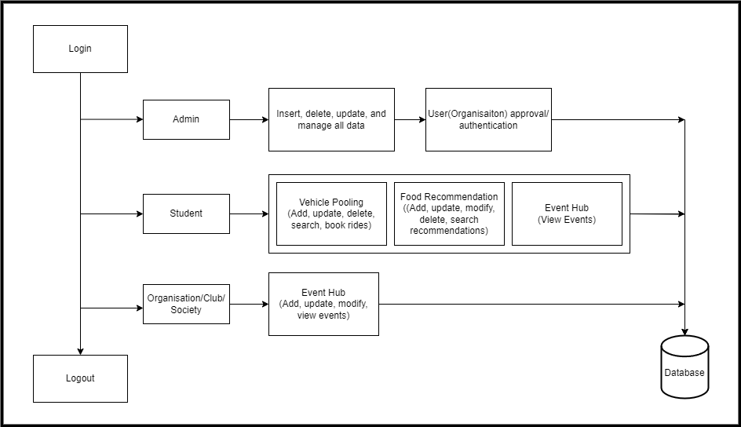
BLOCK DIAGRAM
‹#›

Slide 17
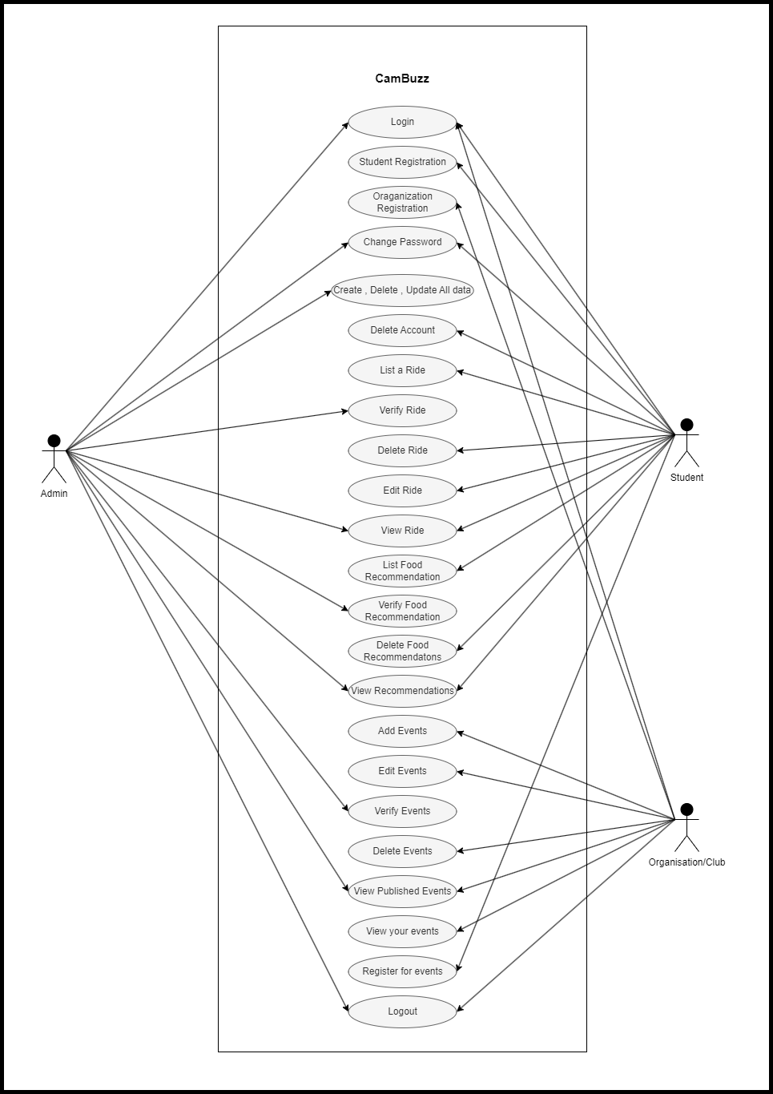
USE CASE DIAGRAM

Slide 18
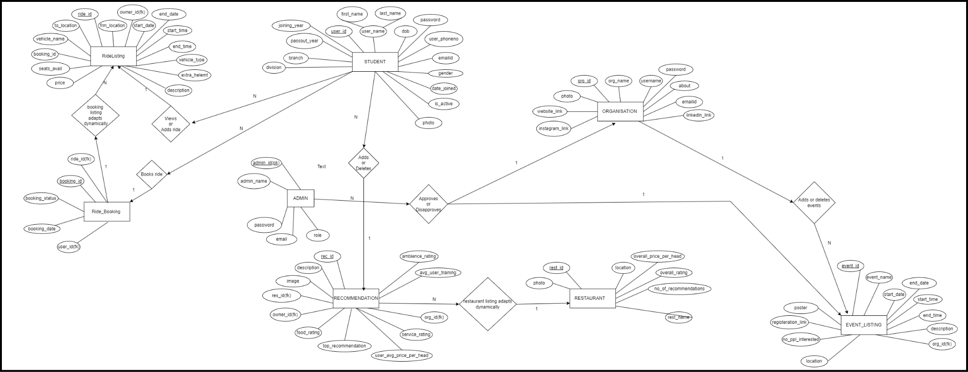
ER DIAGRAM
‹#›

Slide 19
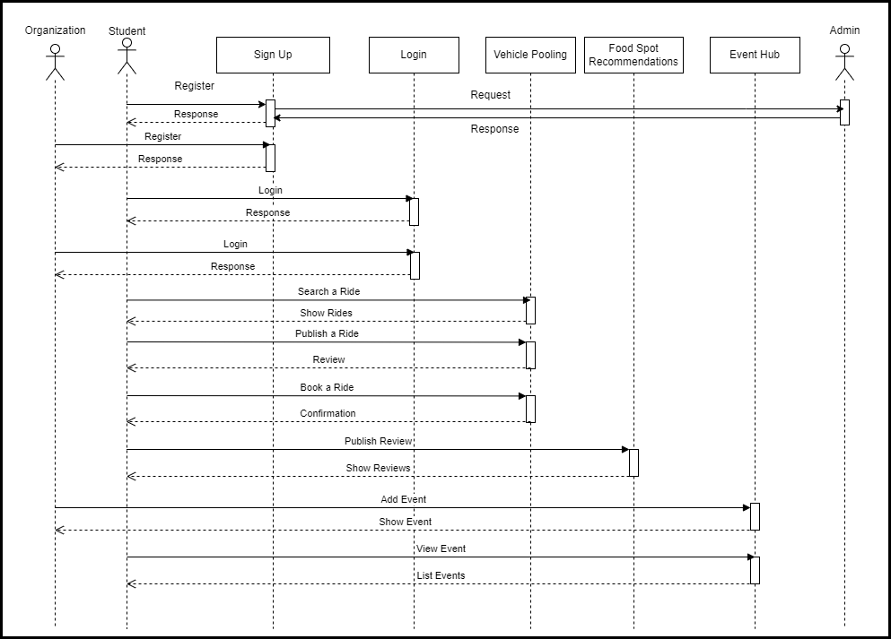
SEQUENCE DIAGRAM
‹#›

Slide 20
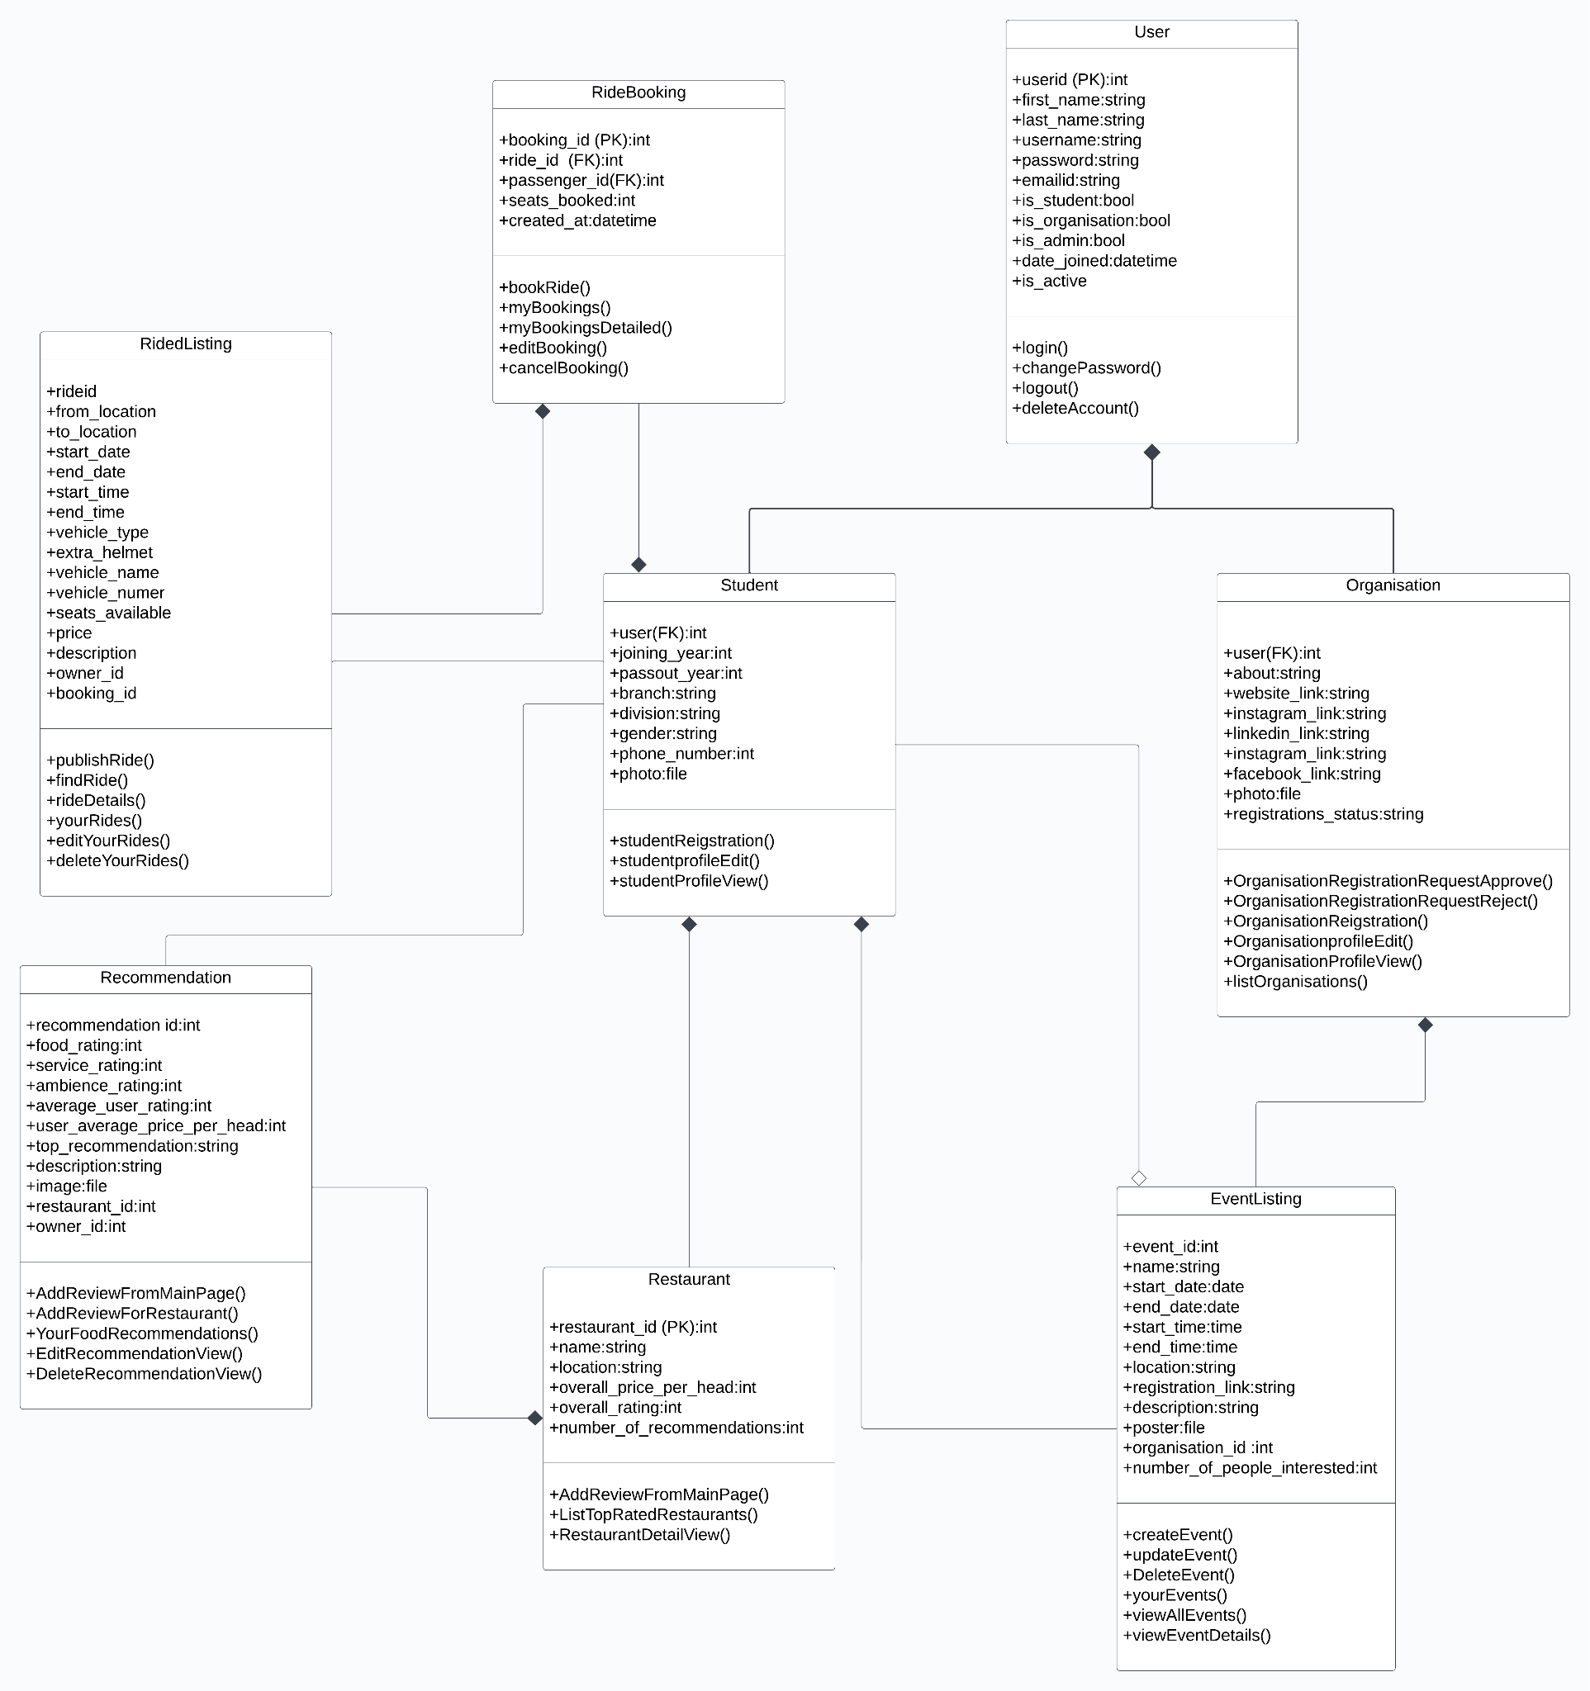
CLASS DIAGRAM

Slide 21
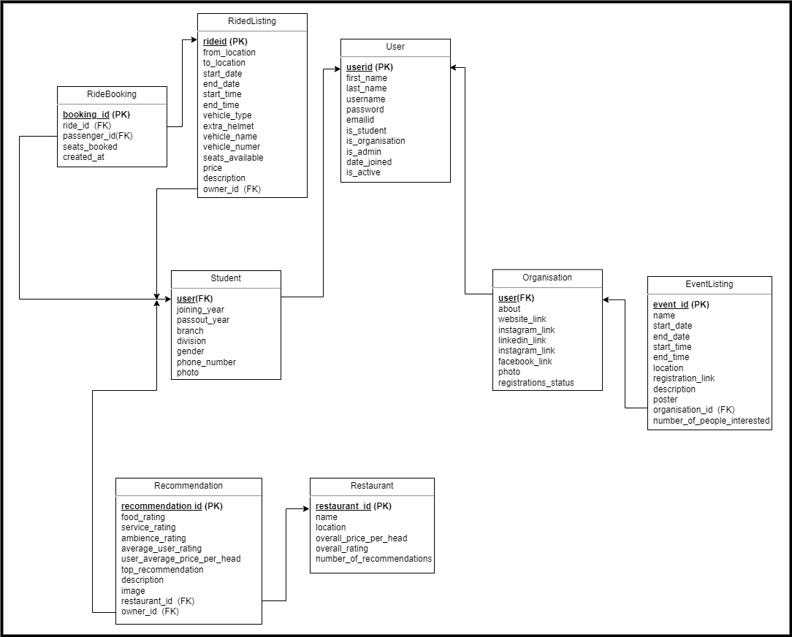
DATABASE DESIGN

Slide 22
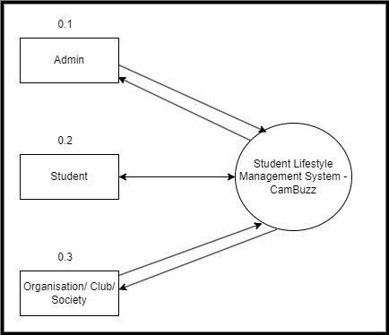
DFD LEVEL 0

Slide 23
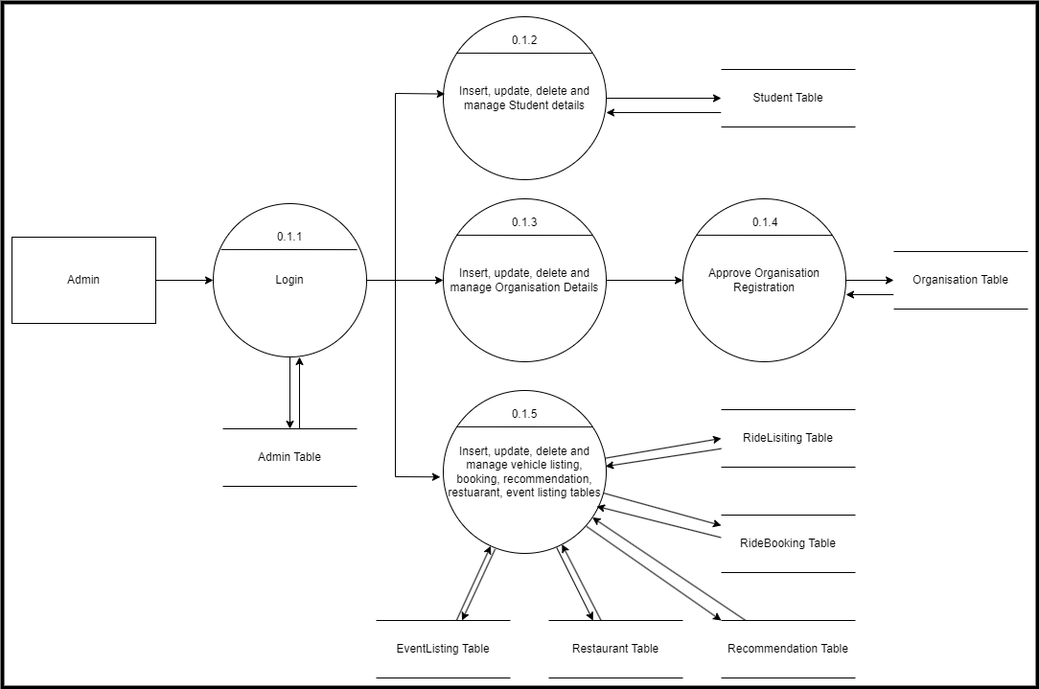
DFD LEVEL 1.1

Slide 24
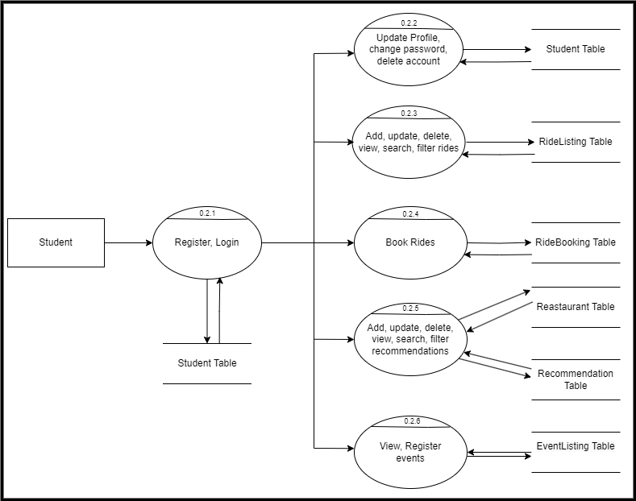
DFD LEVEL 1.2
‹#›

Slide 25
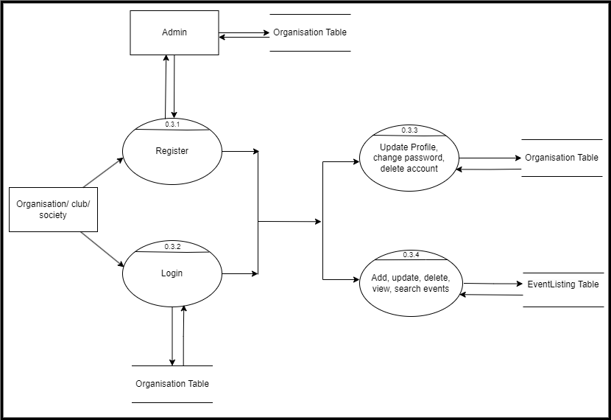
DFD LEVEL 1.3

Slide 26
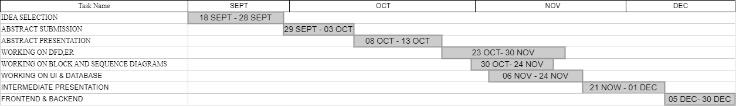
PROJECT TIMELINE

Slide 27




IMPLEMENTATION DETAILS
Coding Language
Frameworks
Database
Version Control
HTML, CSS, JS, Python
Django
PostgreSQL
Git , GitHub

Slide 28
SCREENSHOTS OF
WORK DONE

Slide 29
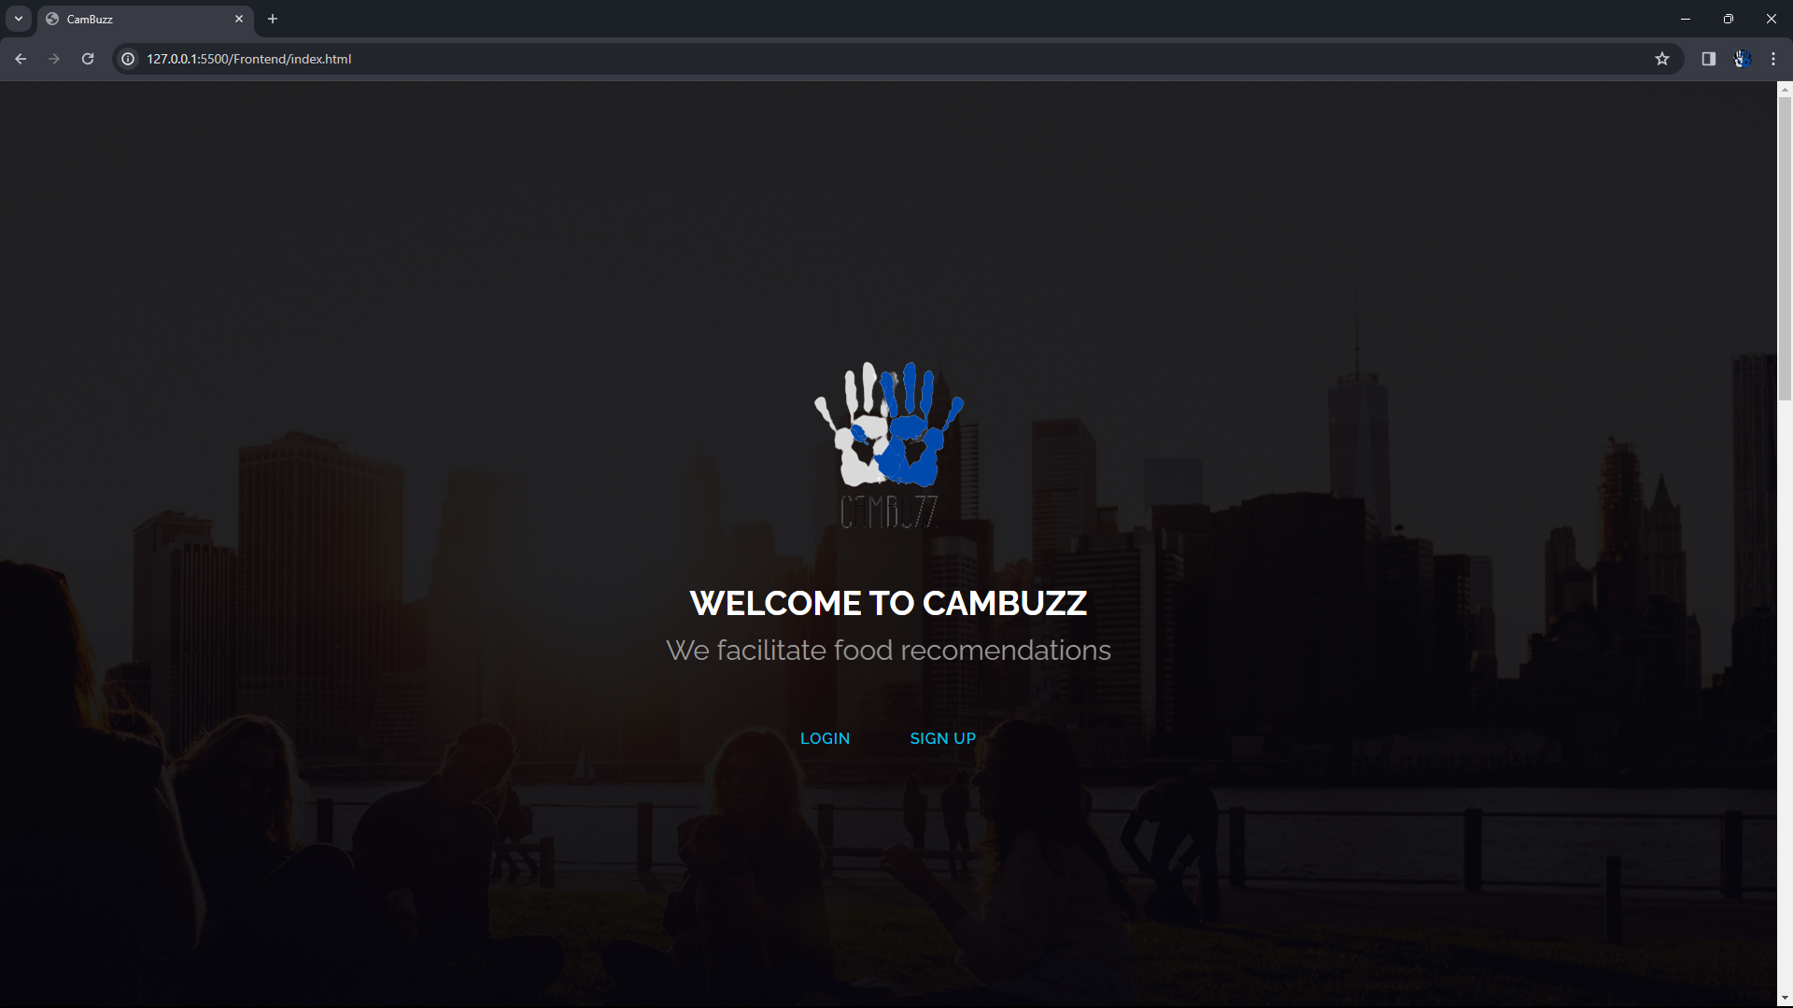
INDEX PAGE

Slide 30
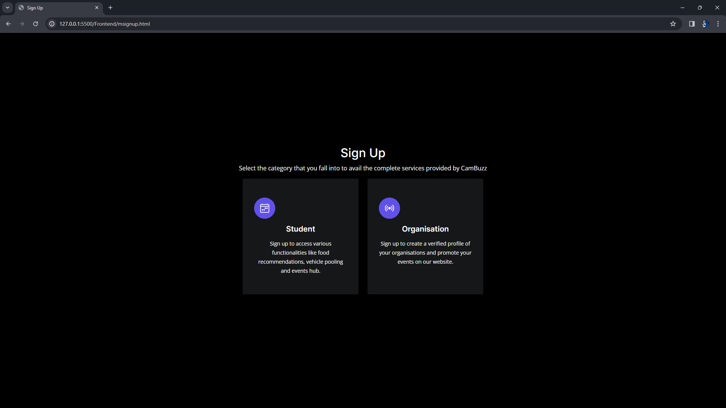
SIGN UP PAGES

Slide 31
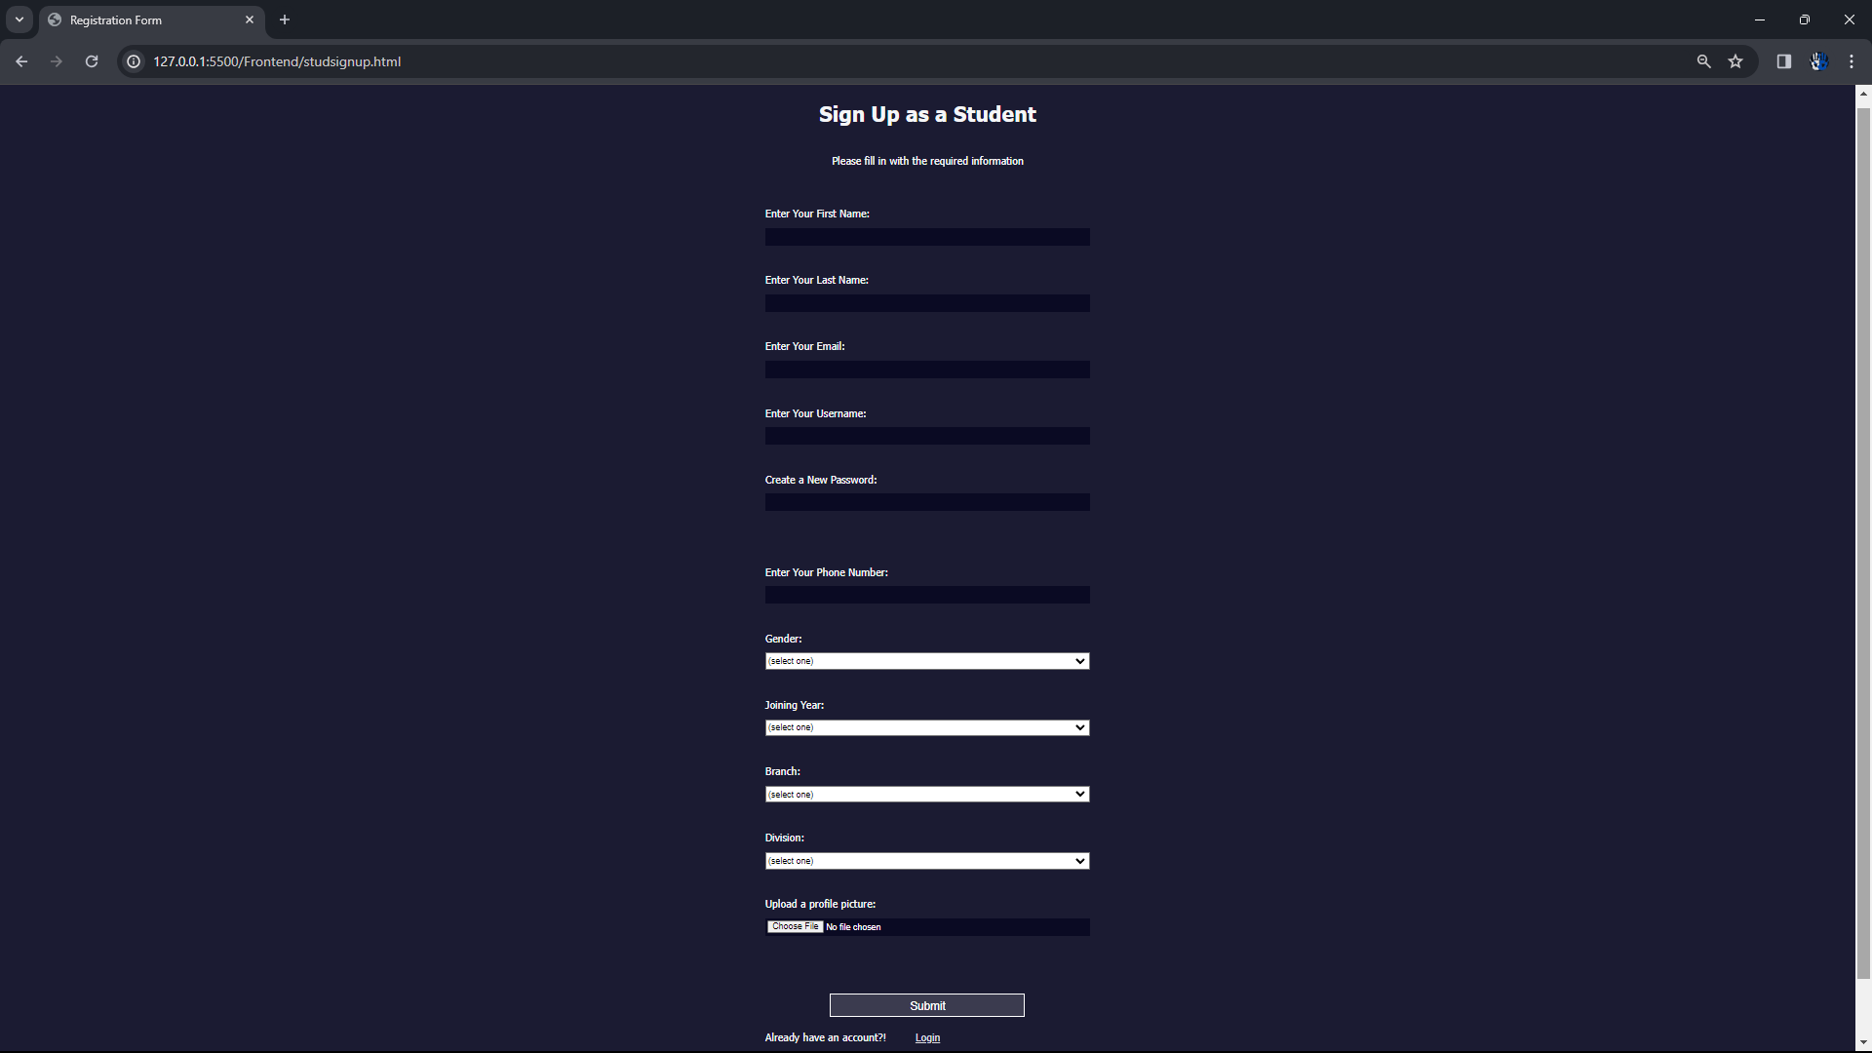
STUDENT SIGN UP

Slide 32
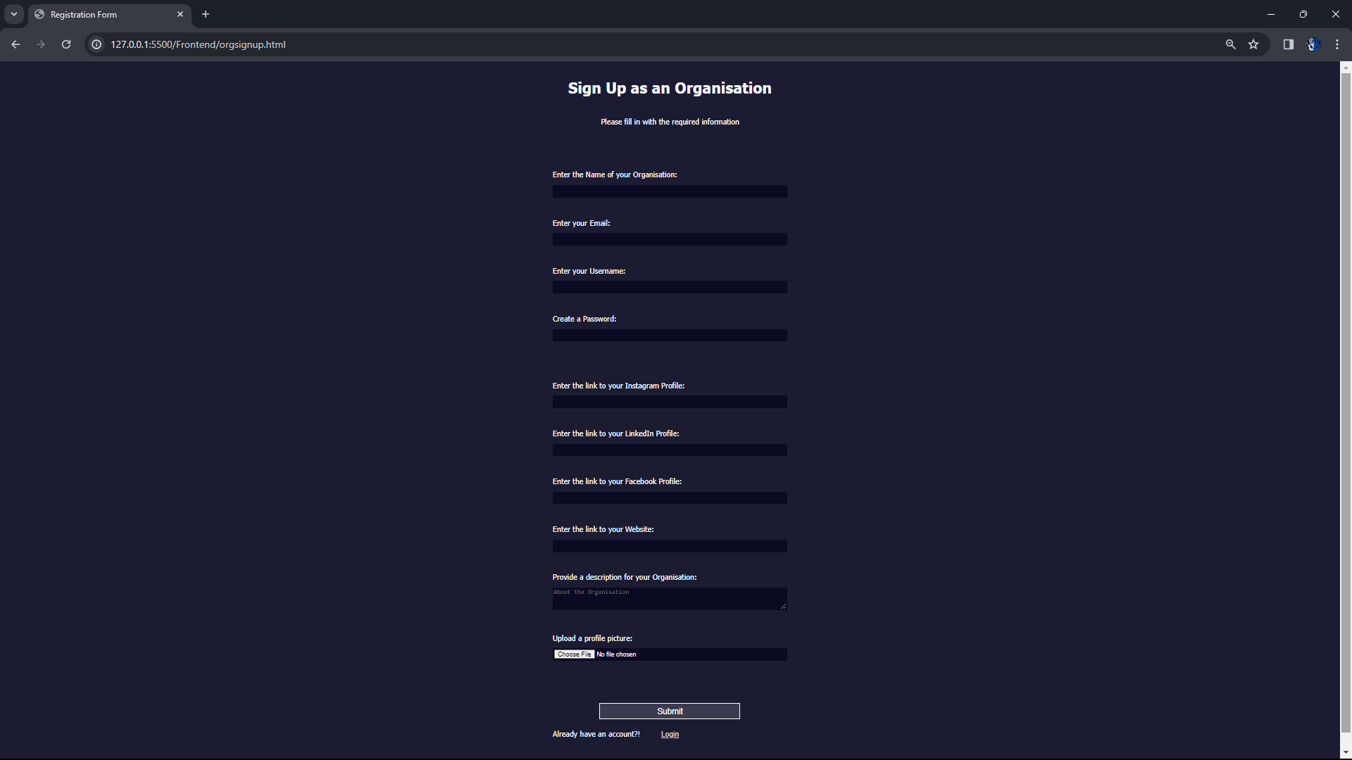
ORGANISATION SIGN UP

Slide 33
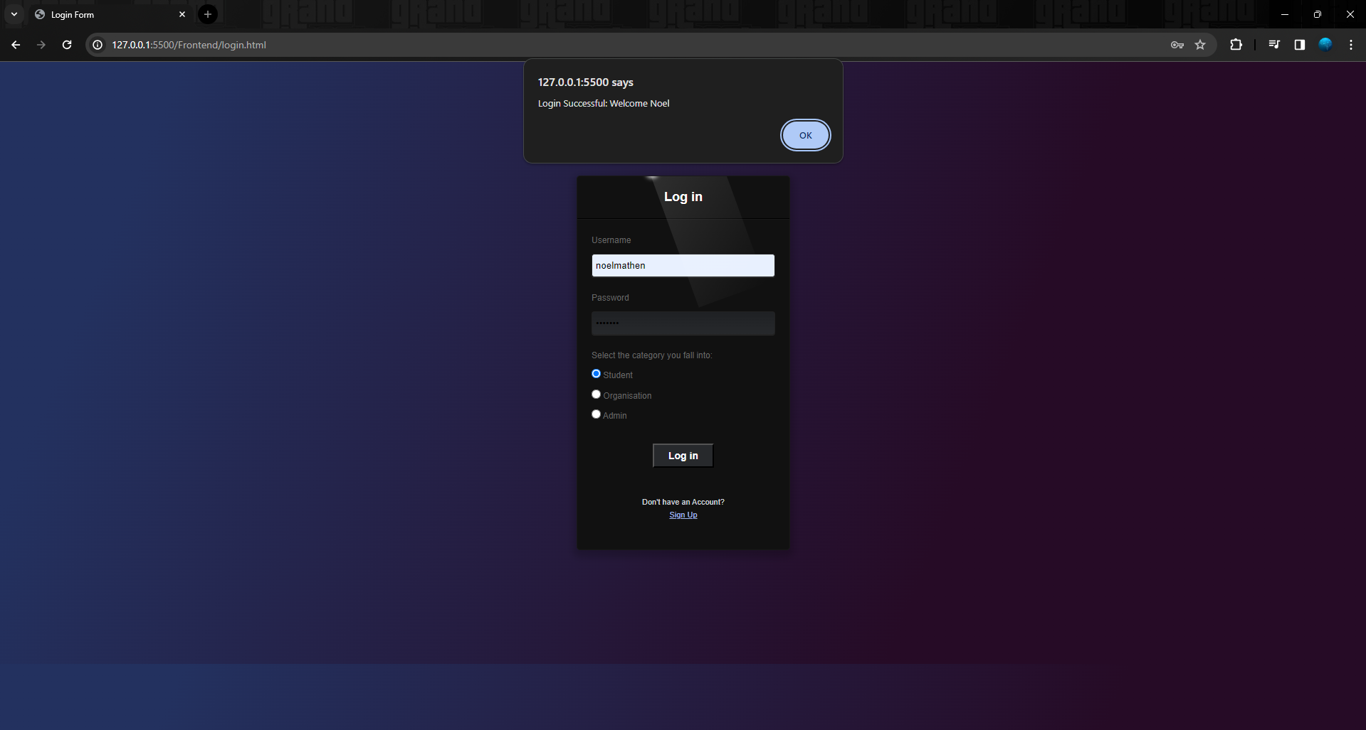
LOGIN PAGE

Slide 34
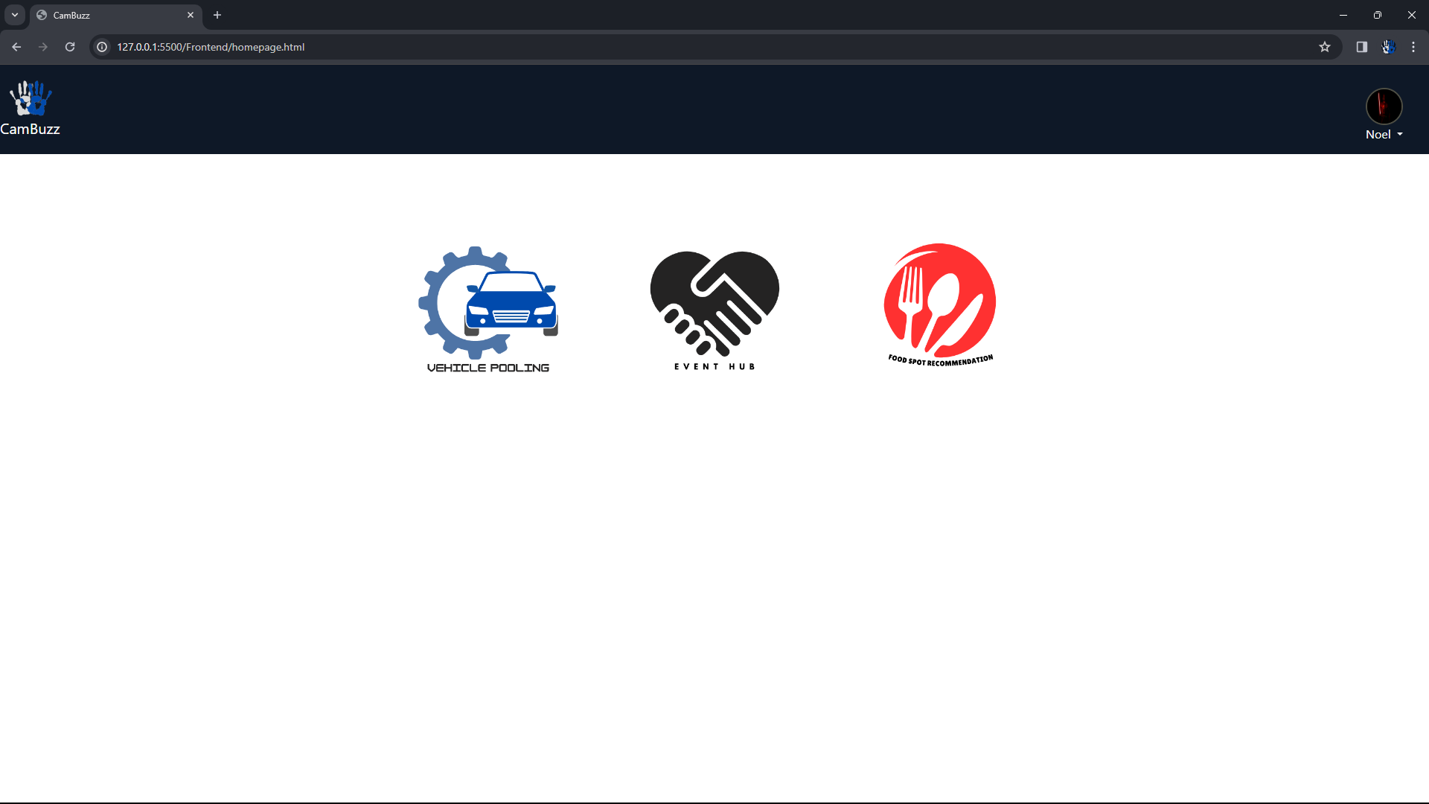
HOME PAGE

Slide 35
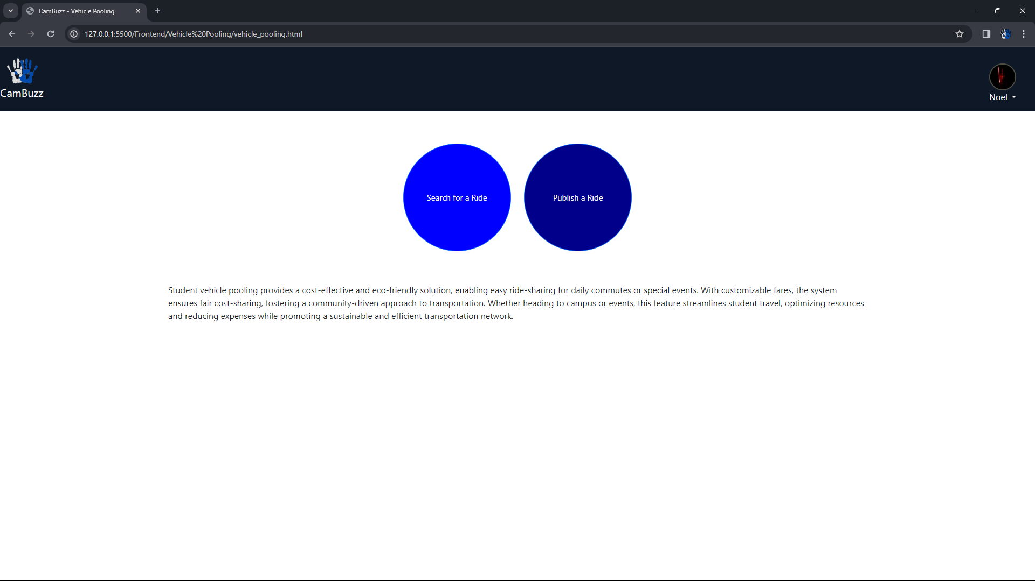
VEHICLE POOLING HOME PAGE

Slide 36
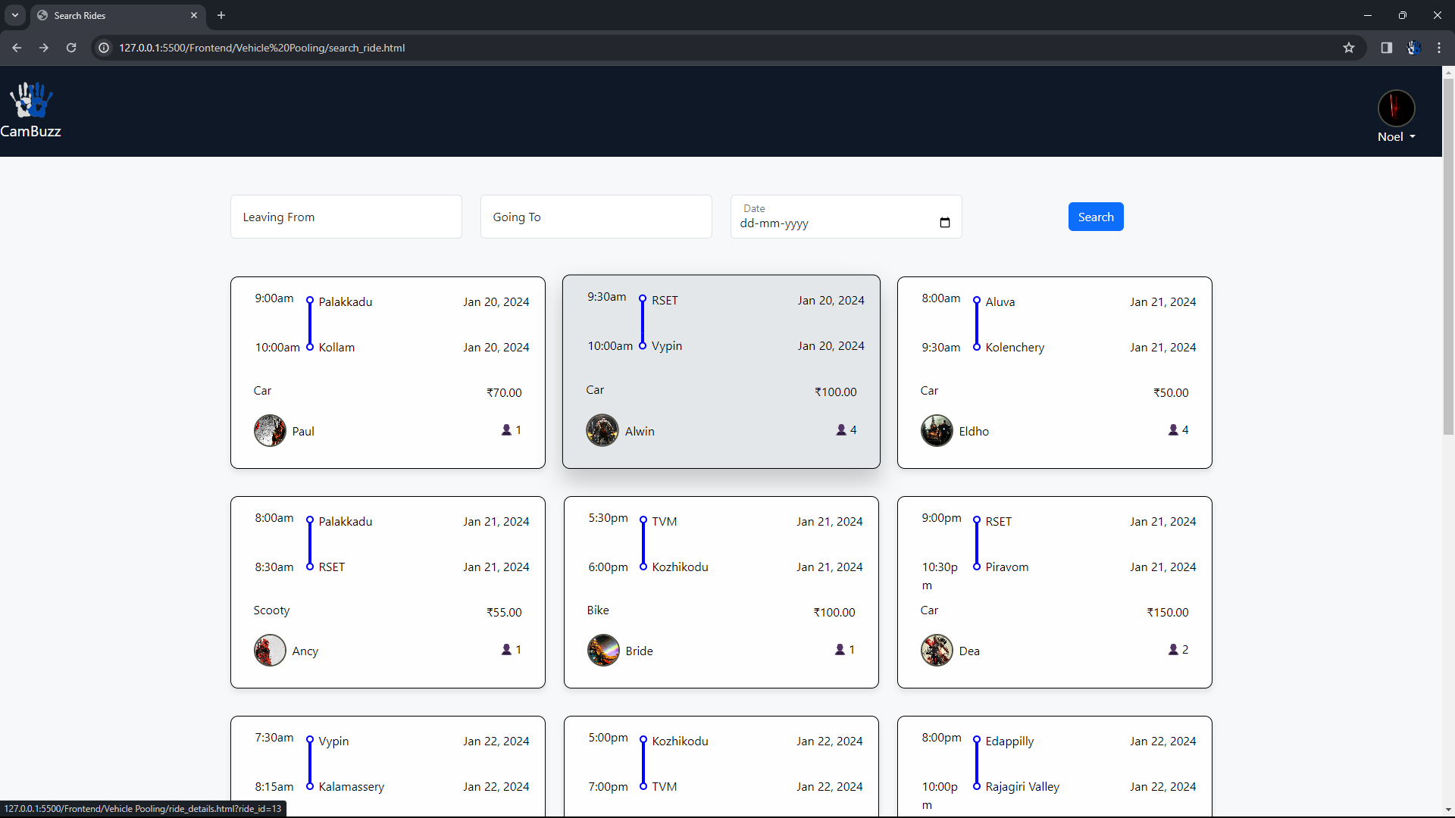
SEARCH AND FILTER RIDE

Slide 37
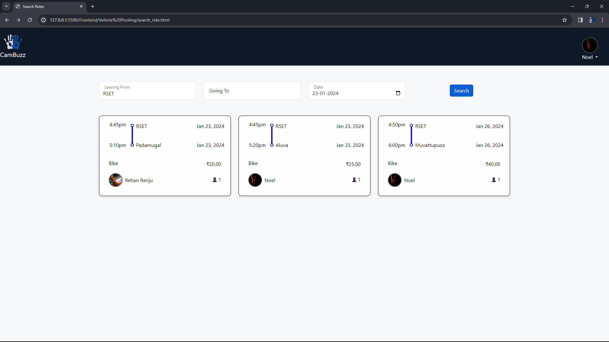
FILTERING BASED ON LOCATION AND DATE

Slide 38
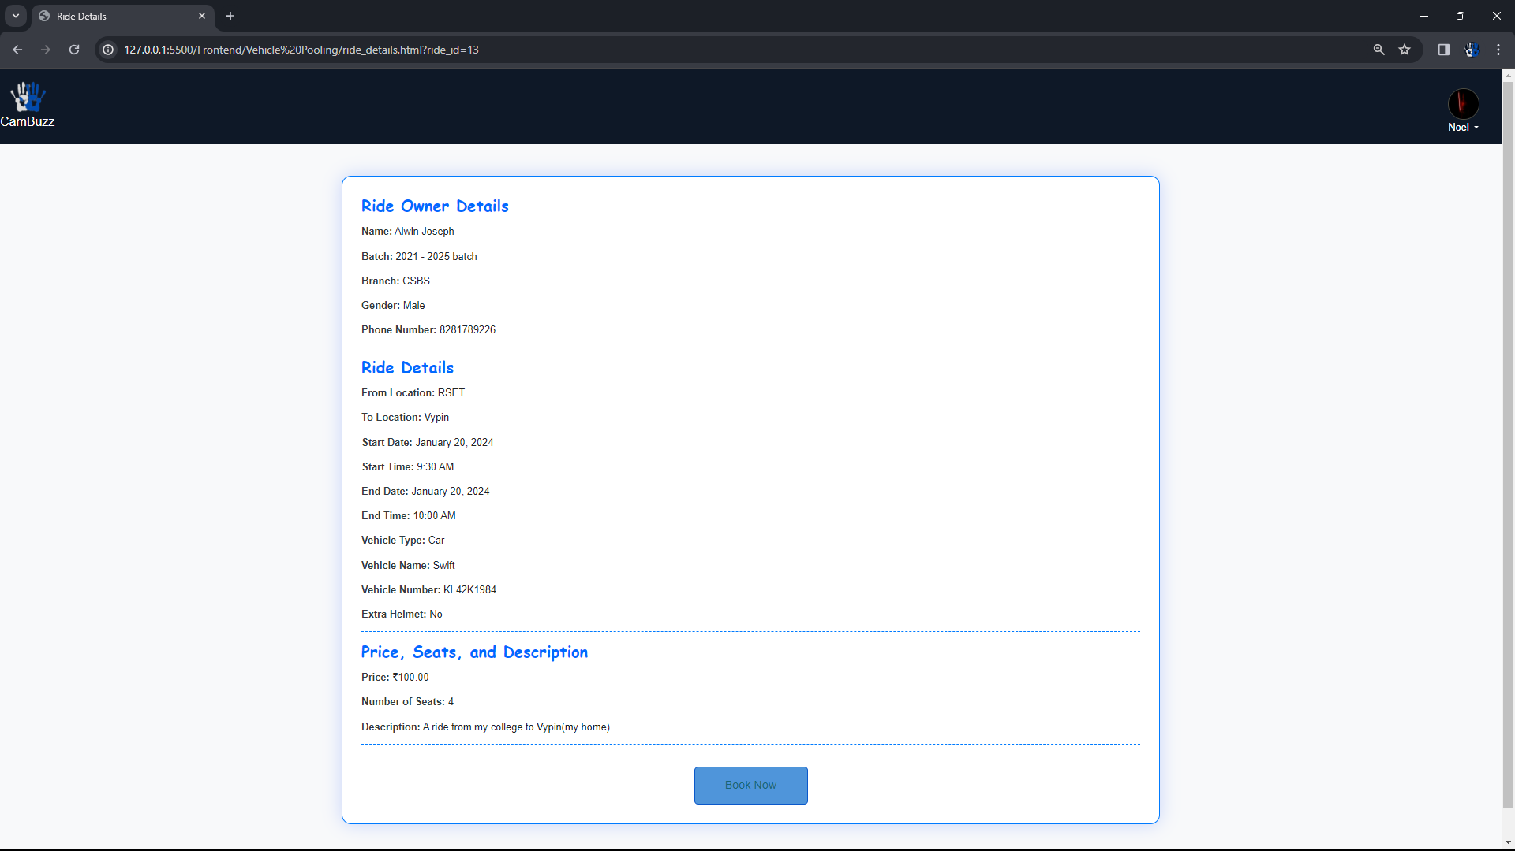
RIDE DETAILS

Slide 39
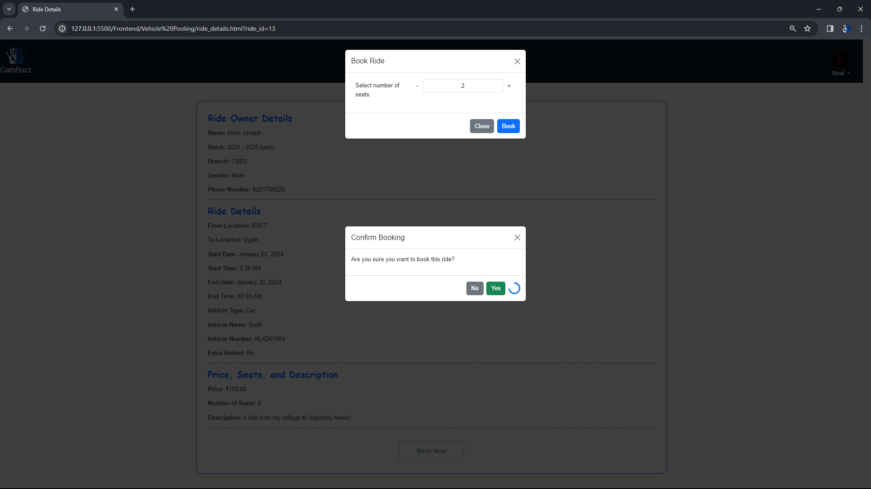
BOOK RIDE

Slide 40
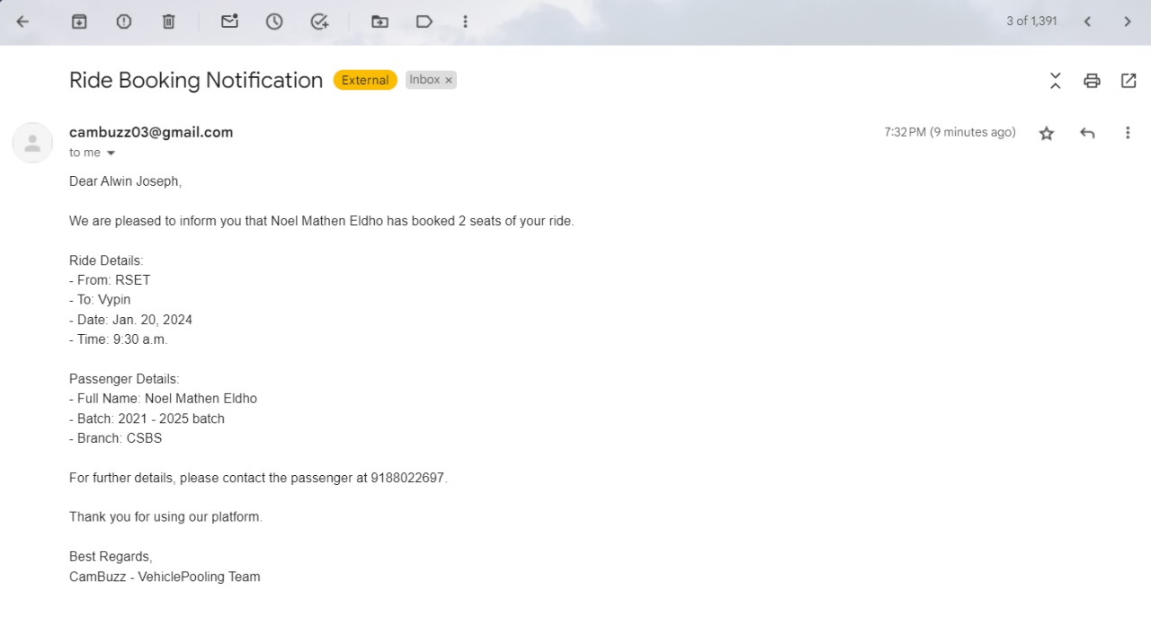
BOOKING EMAIL NOTIFICATION

Slide 41
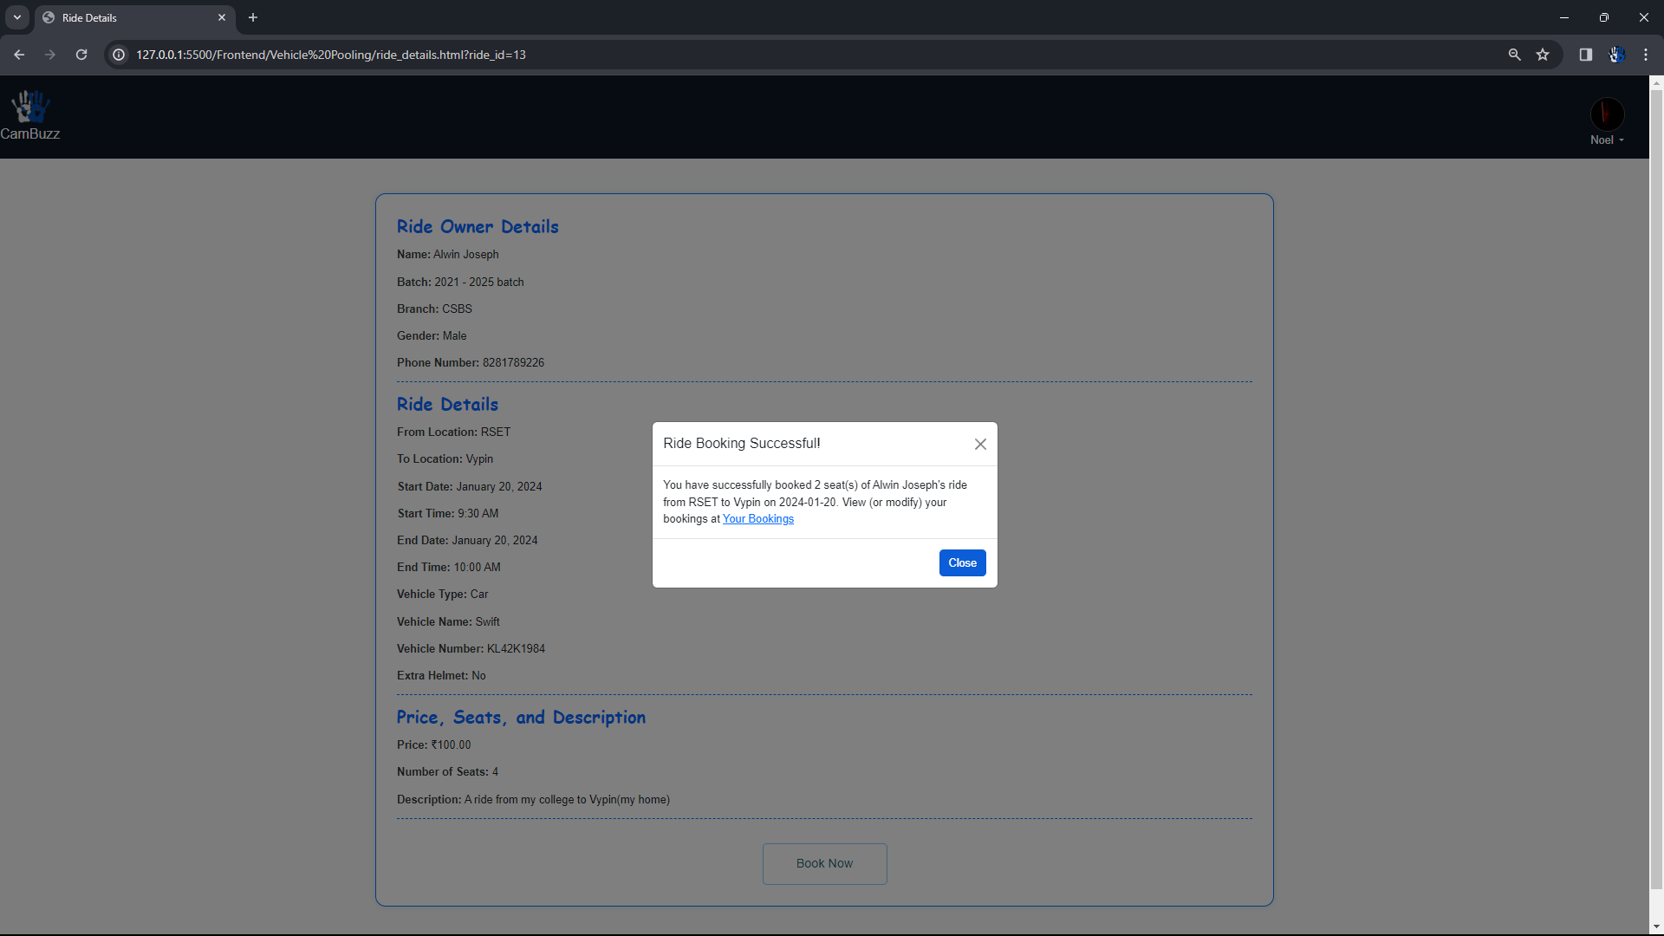
BOOKING SUCCESS MESSAGE DISPLAY

Slide 42
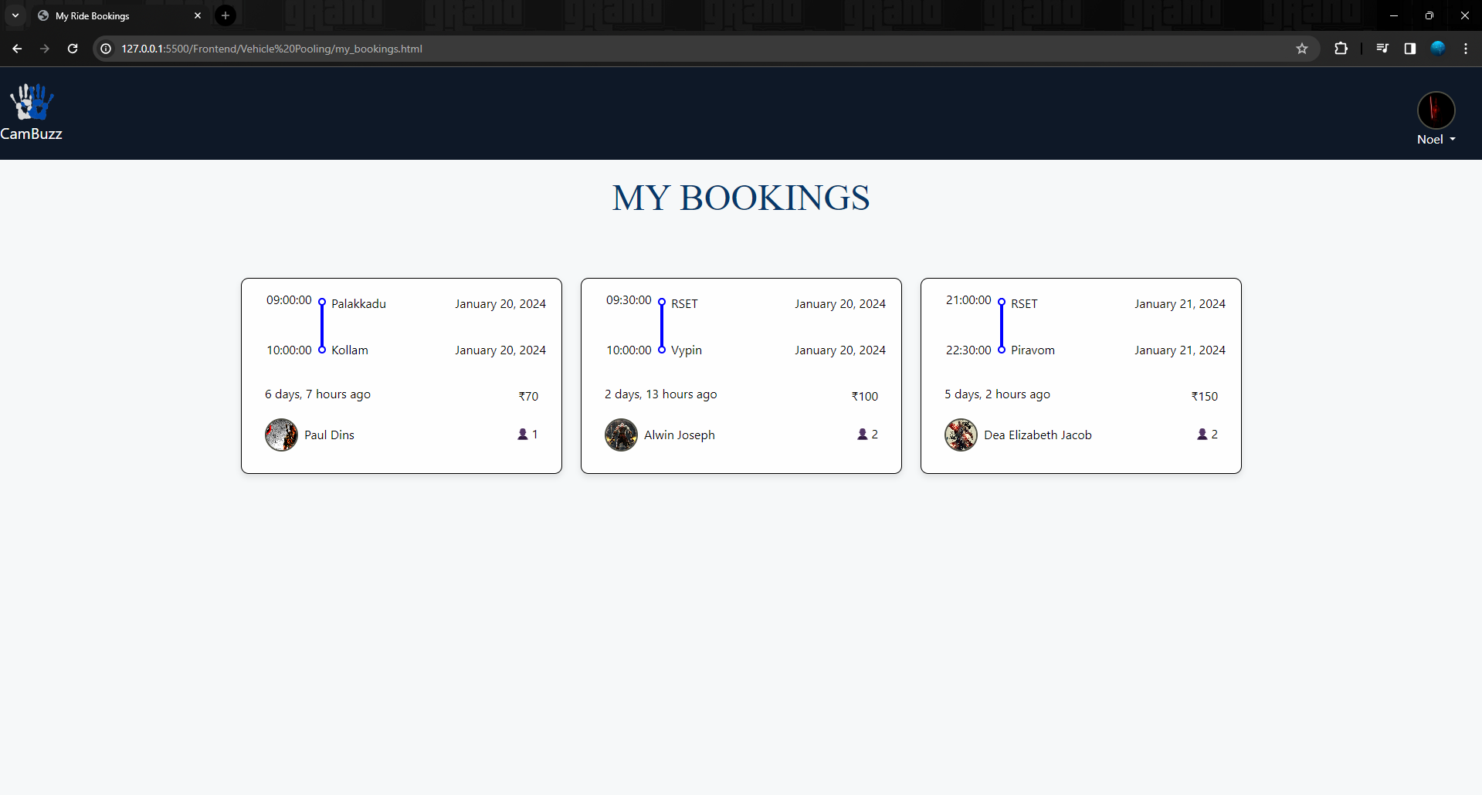
MY BOOKINGS PAGE

Slide 43
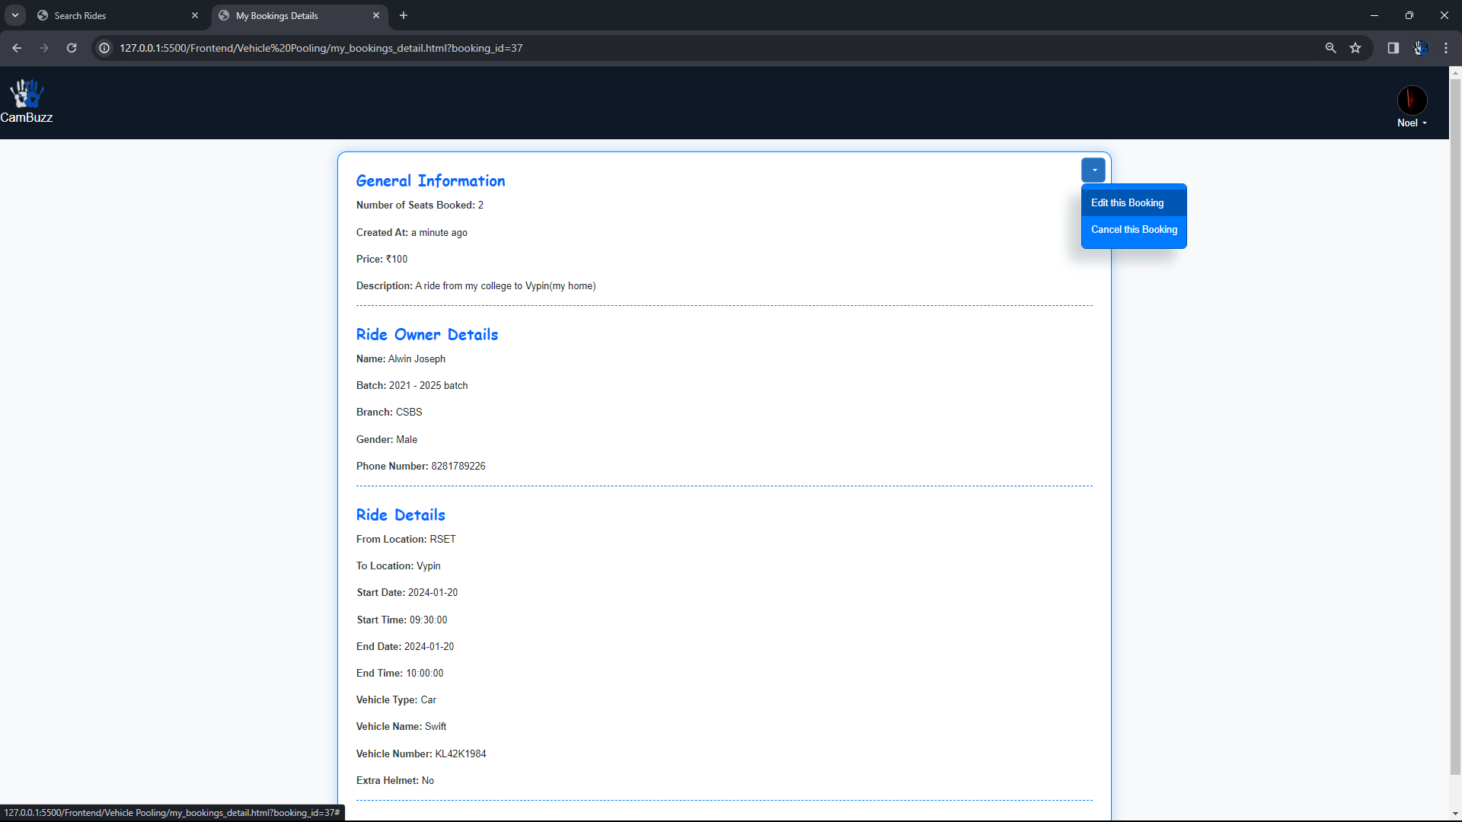
BOOKING DETAILS PAGE

Slide 44
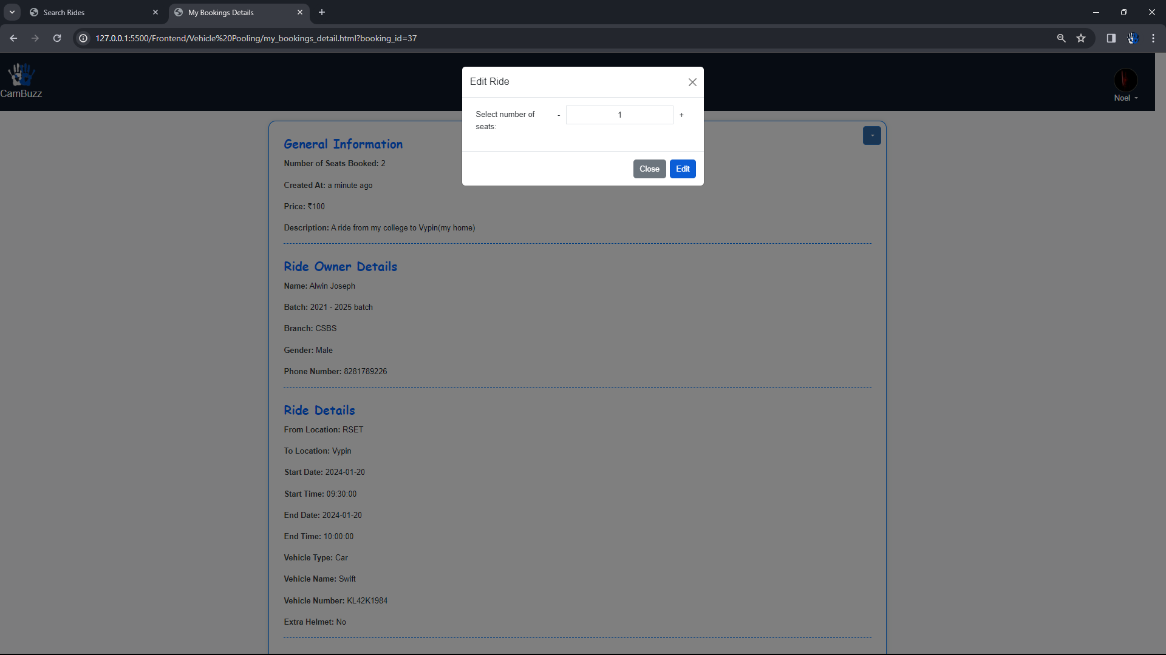
EDIT BOOKING

Slide 45
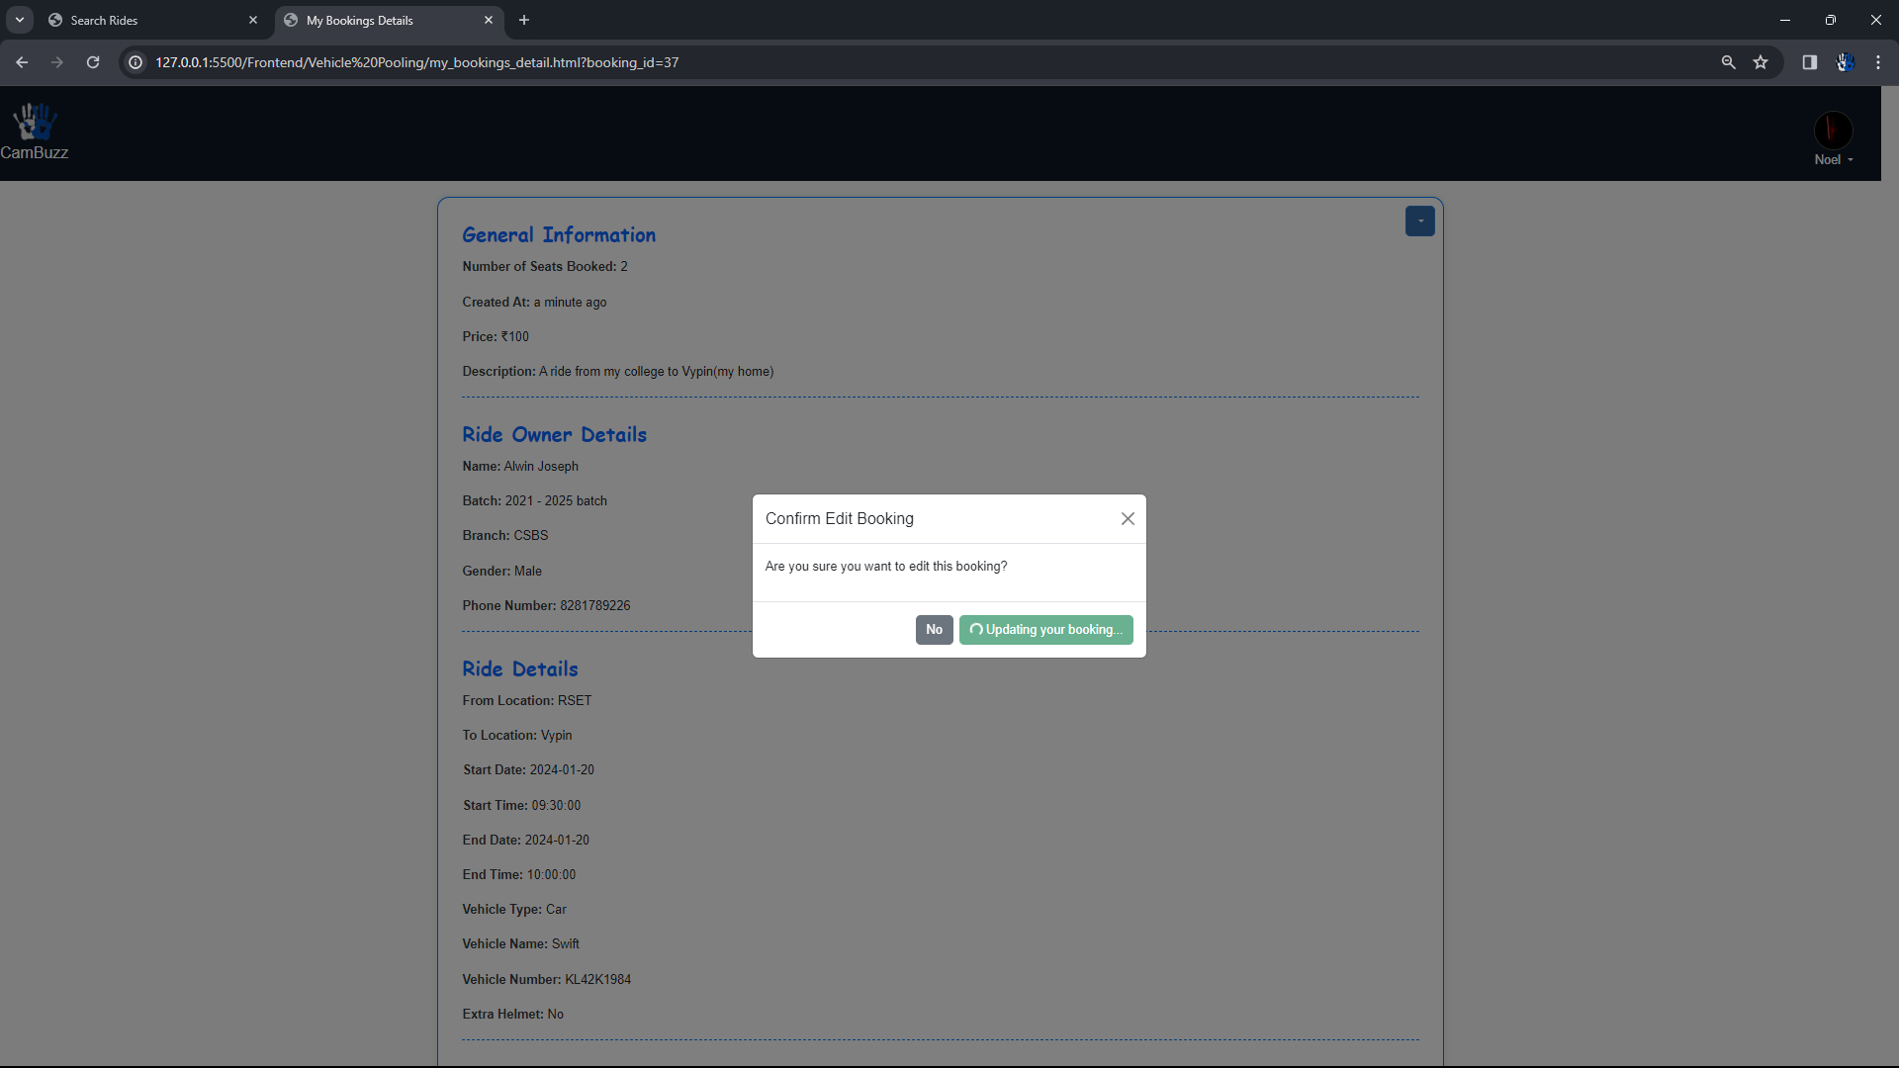
EDIT BOOKING CONFIRMATION

Slide 46
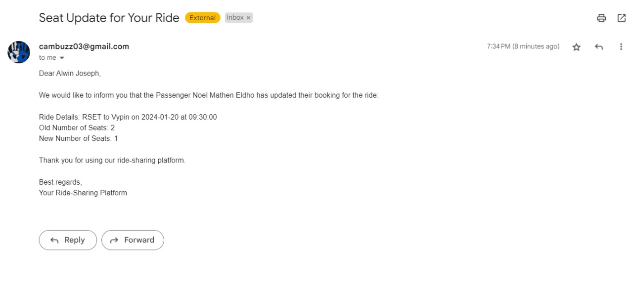
BOOKING EDIT EMAIL NOTIFICATION

Slide 47
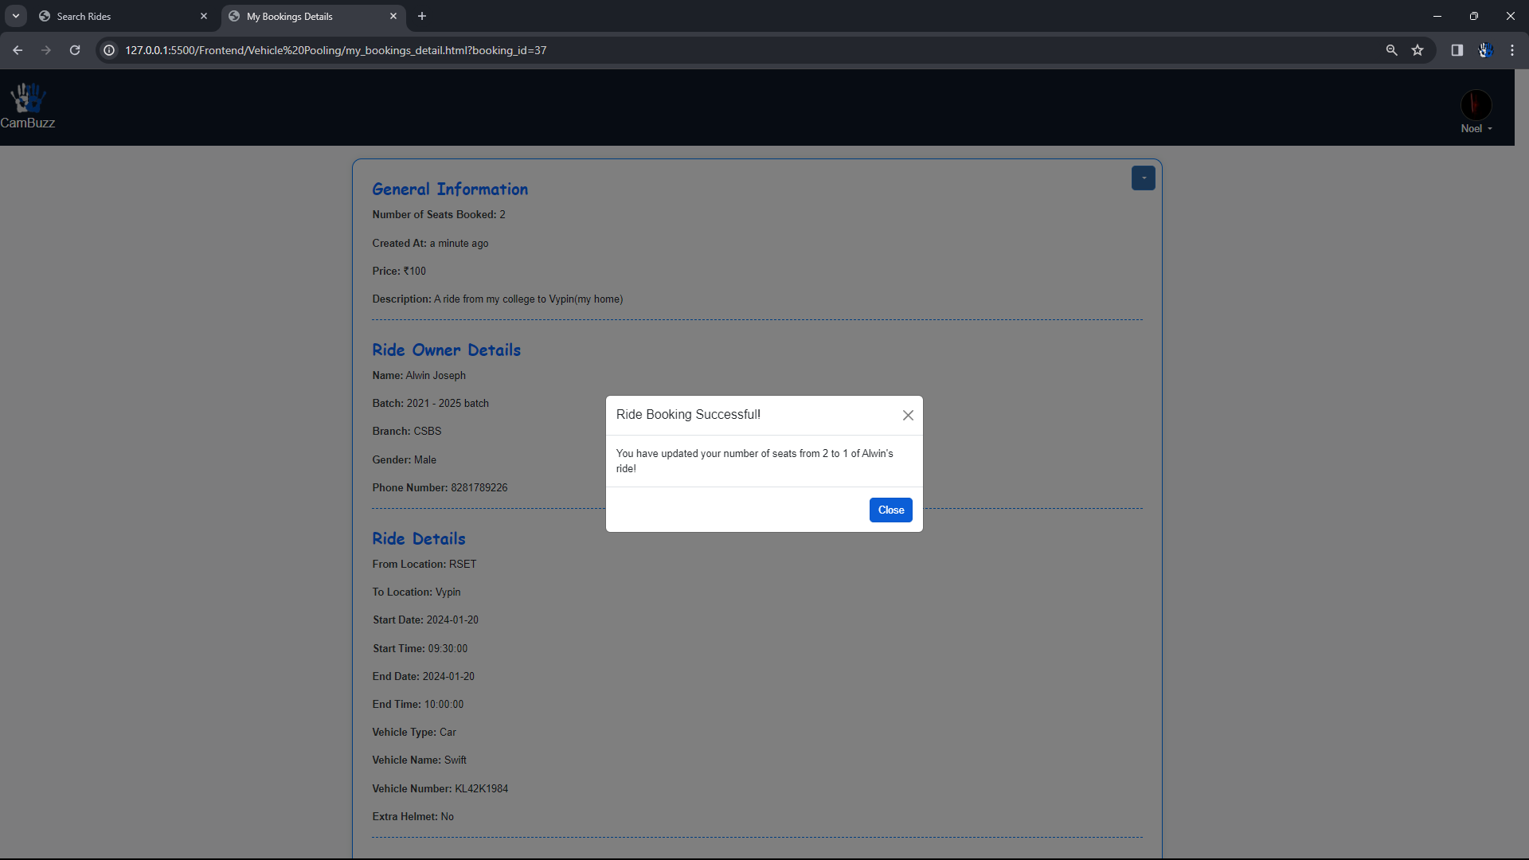
EDIT BOOKING SUCCESS MESSAGE

Slide 48
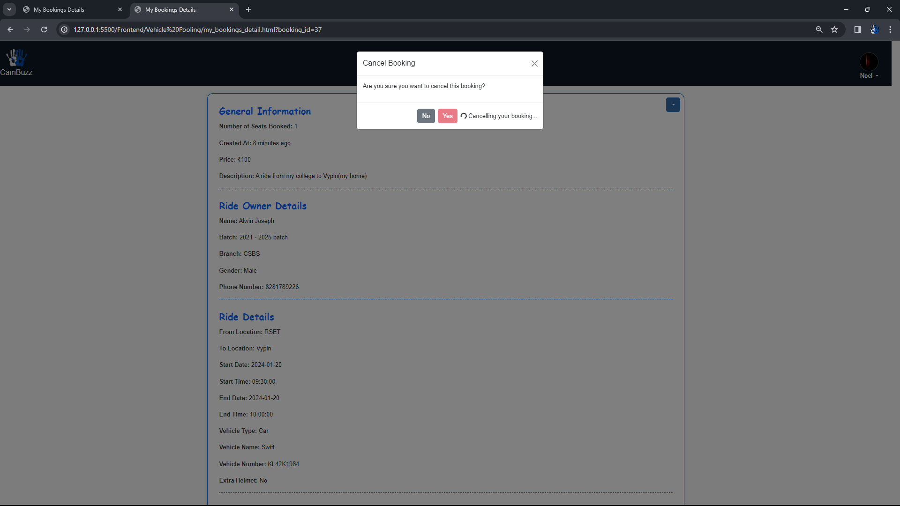
CANCEL BOOKING

Slide 49
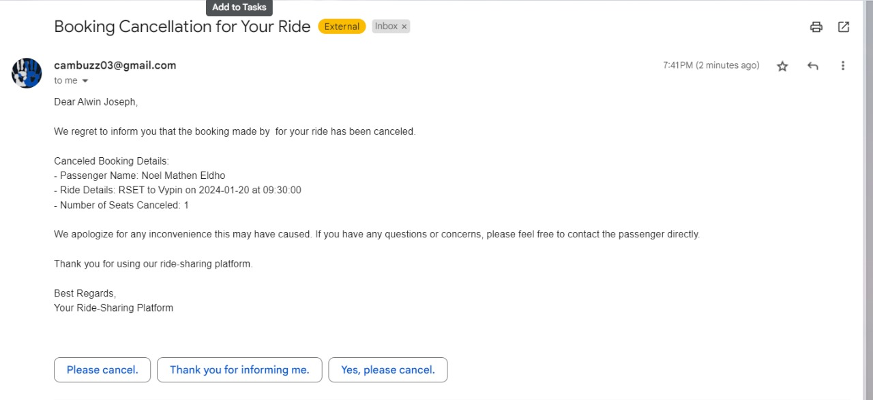
CANCELLATION EMAIL NOTIFICATION

Slide 50
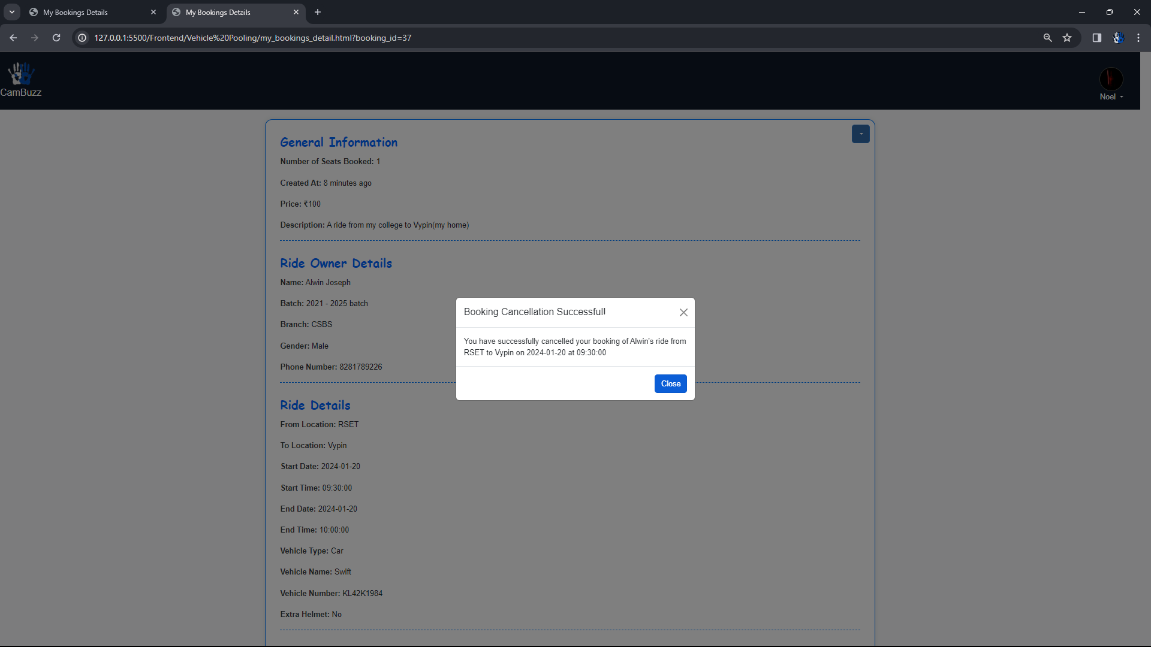
CANCEL BOOKING SUCCESS MESSAGE

Slide 51
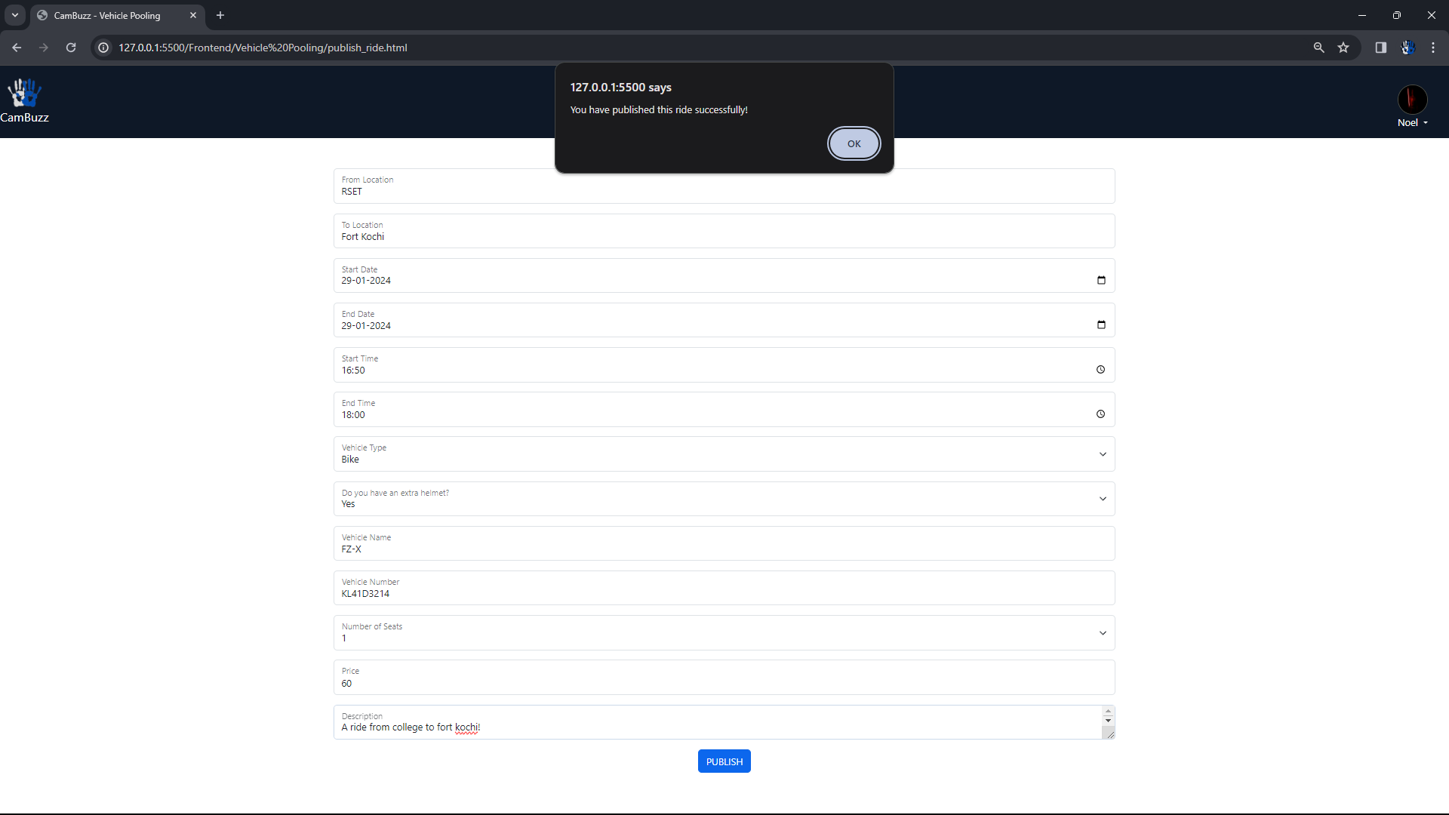
PUBLISH RIDE

Slide 52
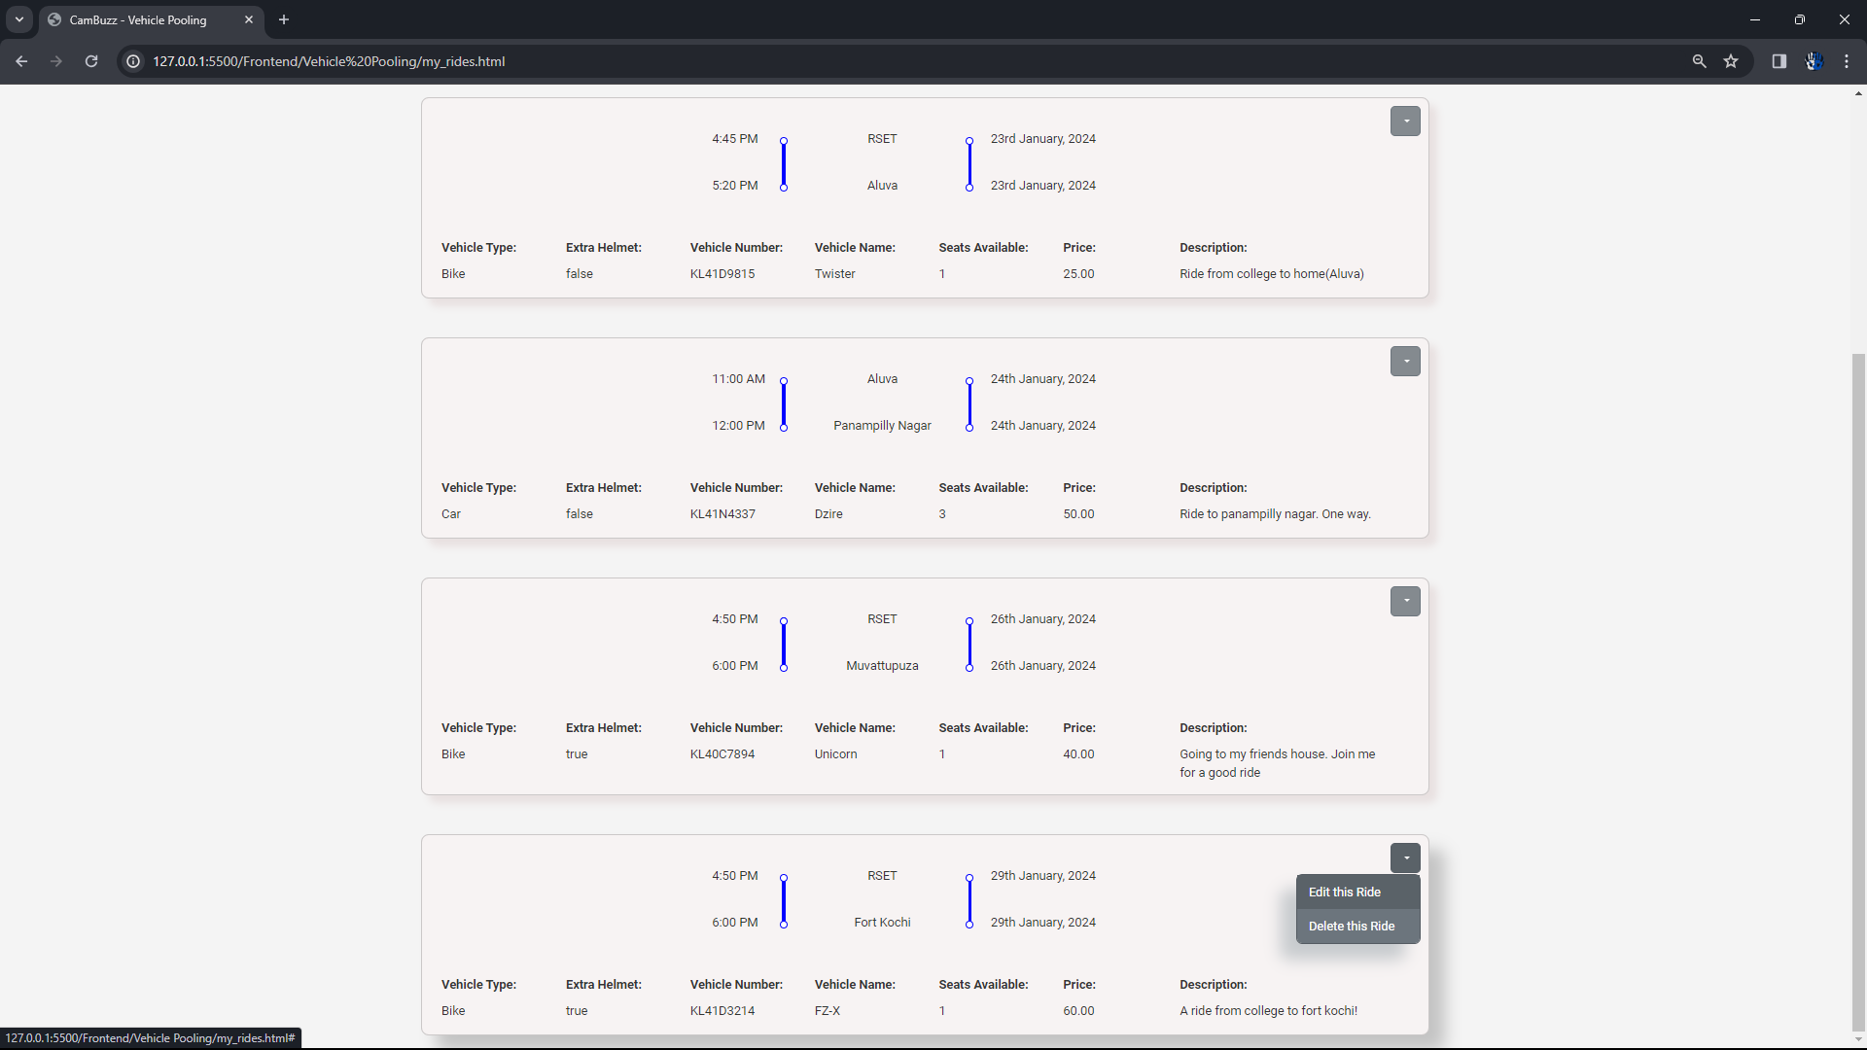
MY RIDES

Slide 53
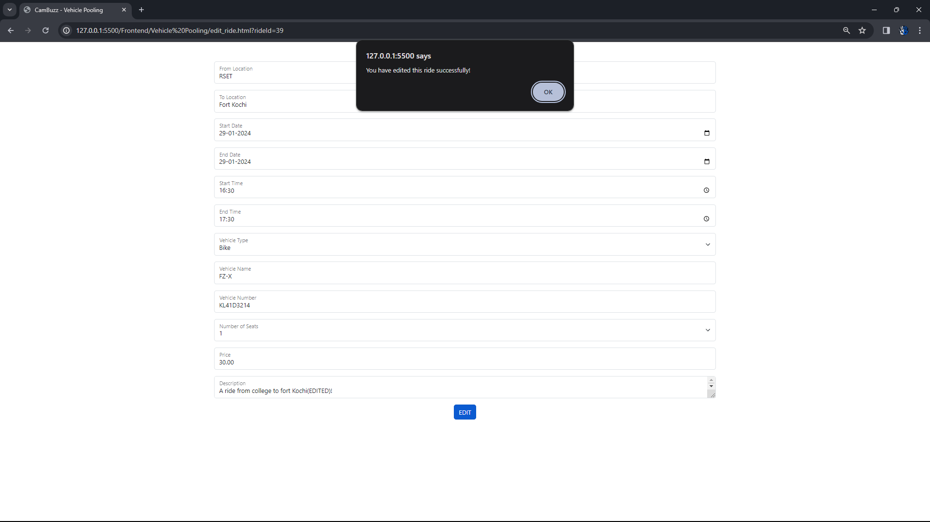
EDIT RIDE

Slide 54
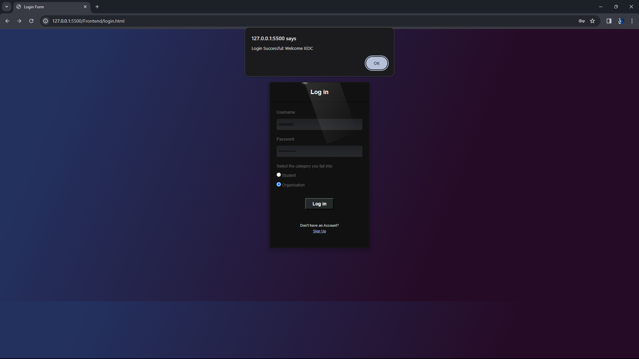
LOGIN AS ORGANISATION

Slide 55
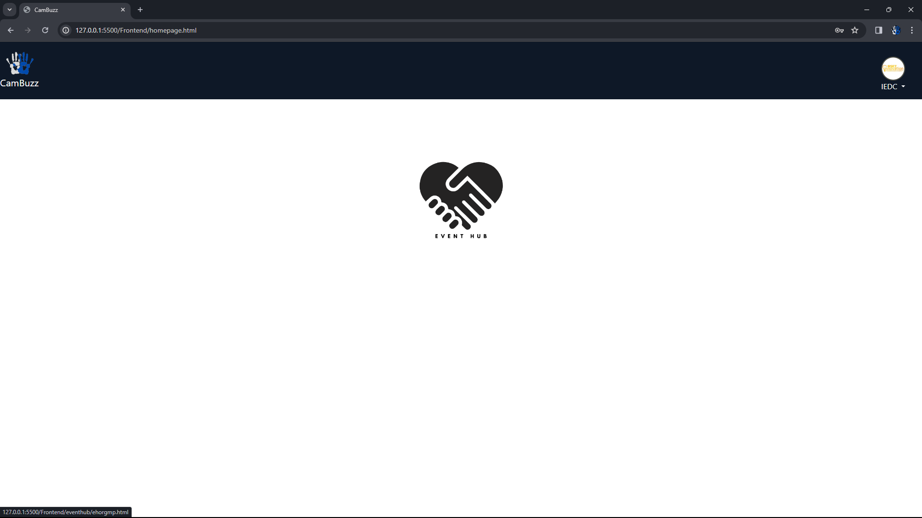
ORGANISATION HOME PAGE

Slide 56
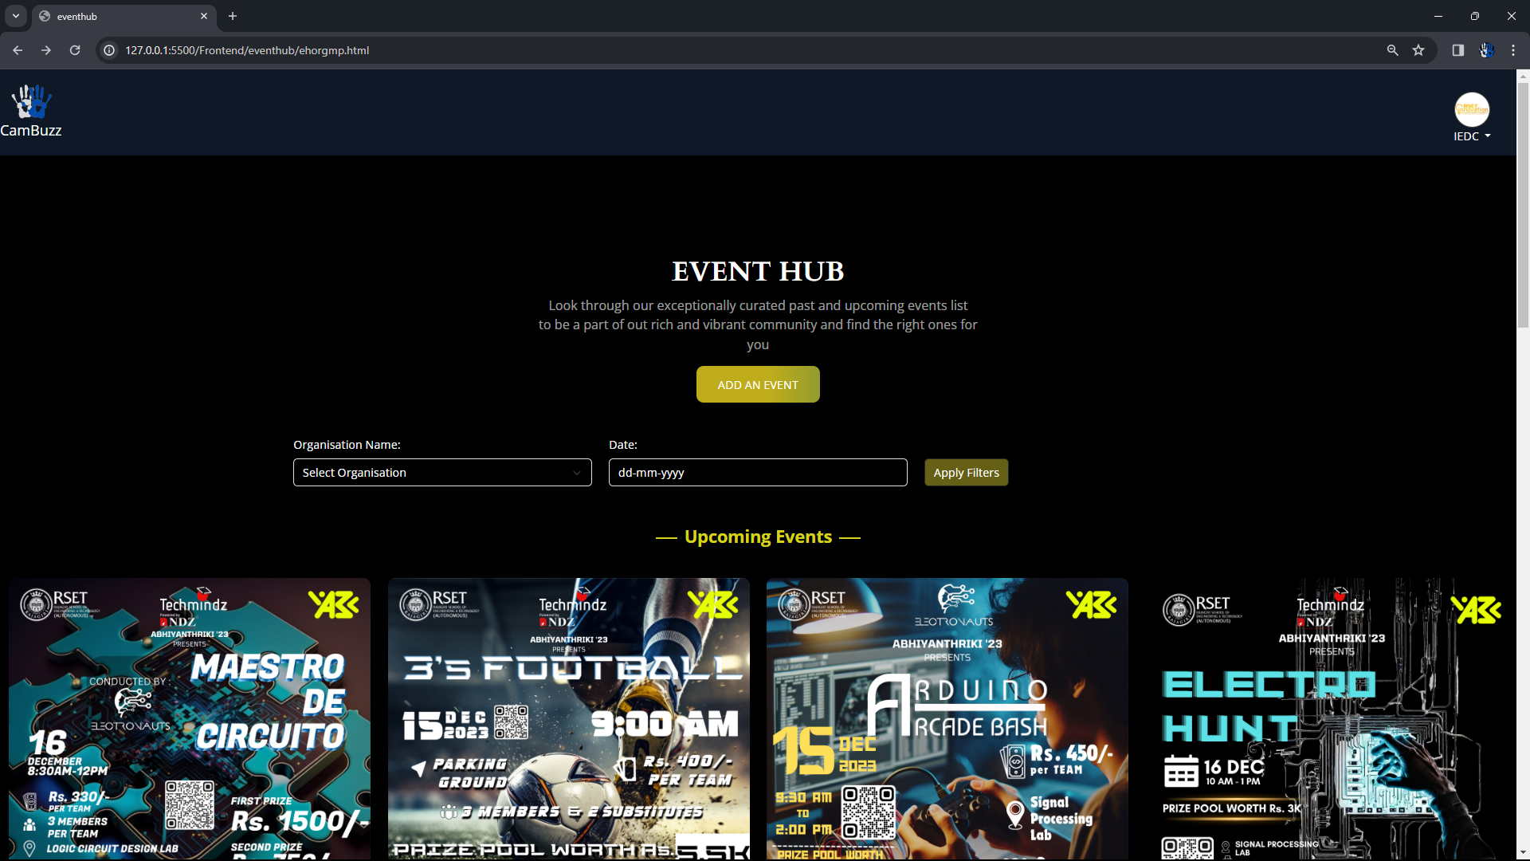
EVENT GALLERY(ORGANISATION)

Slide 57
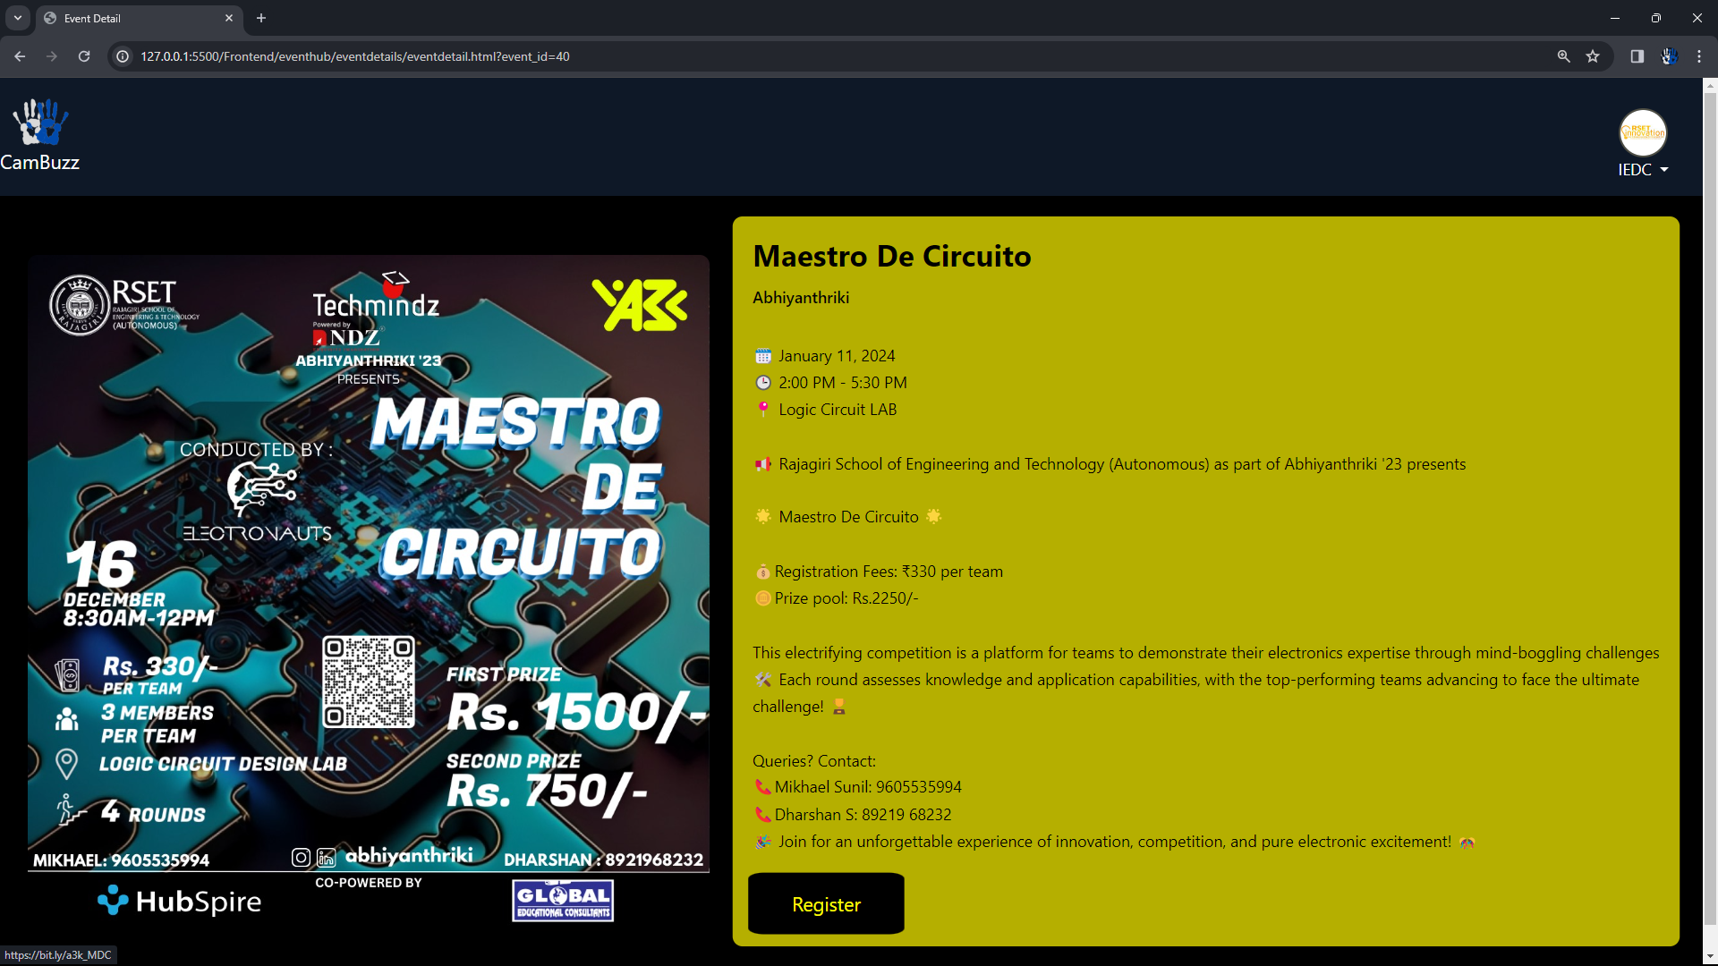
EVENT DESCRIPTION

Slide 58
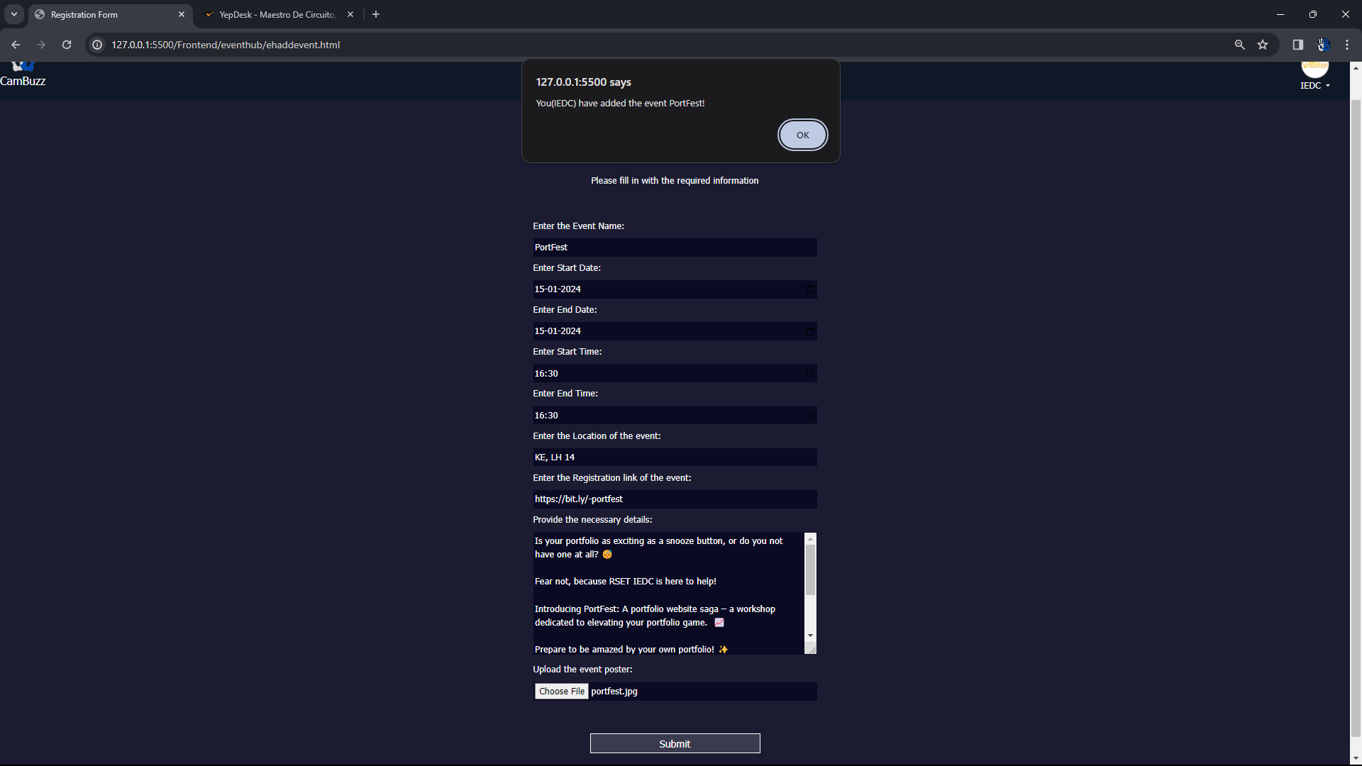
ADD AN EVENT

Slide 59
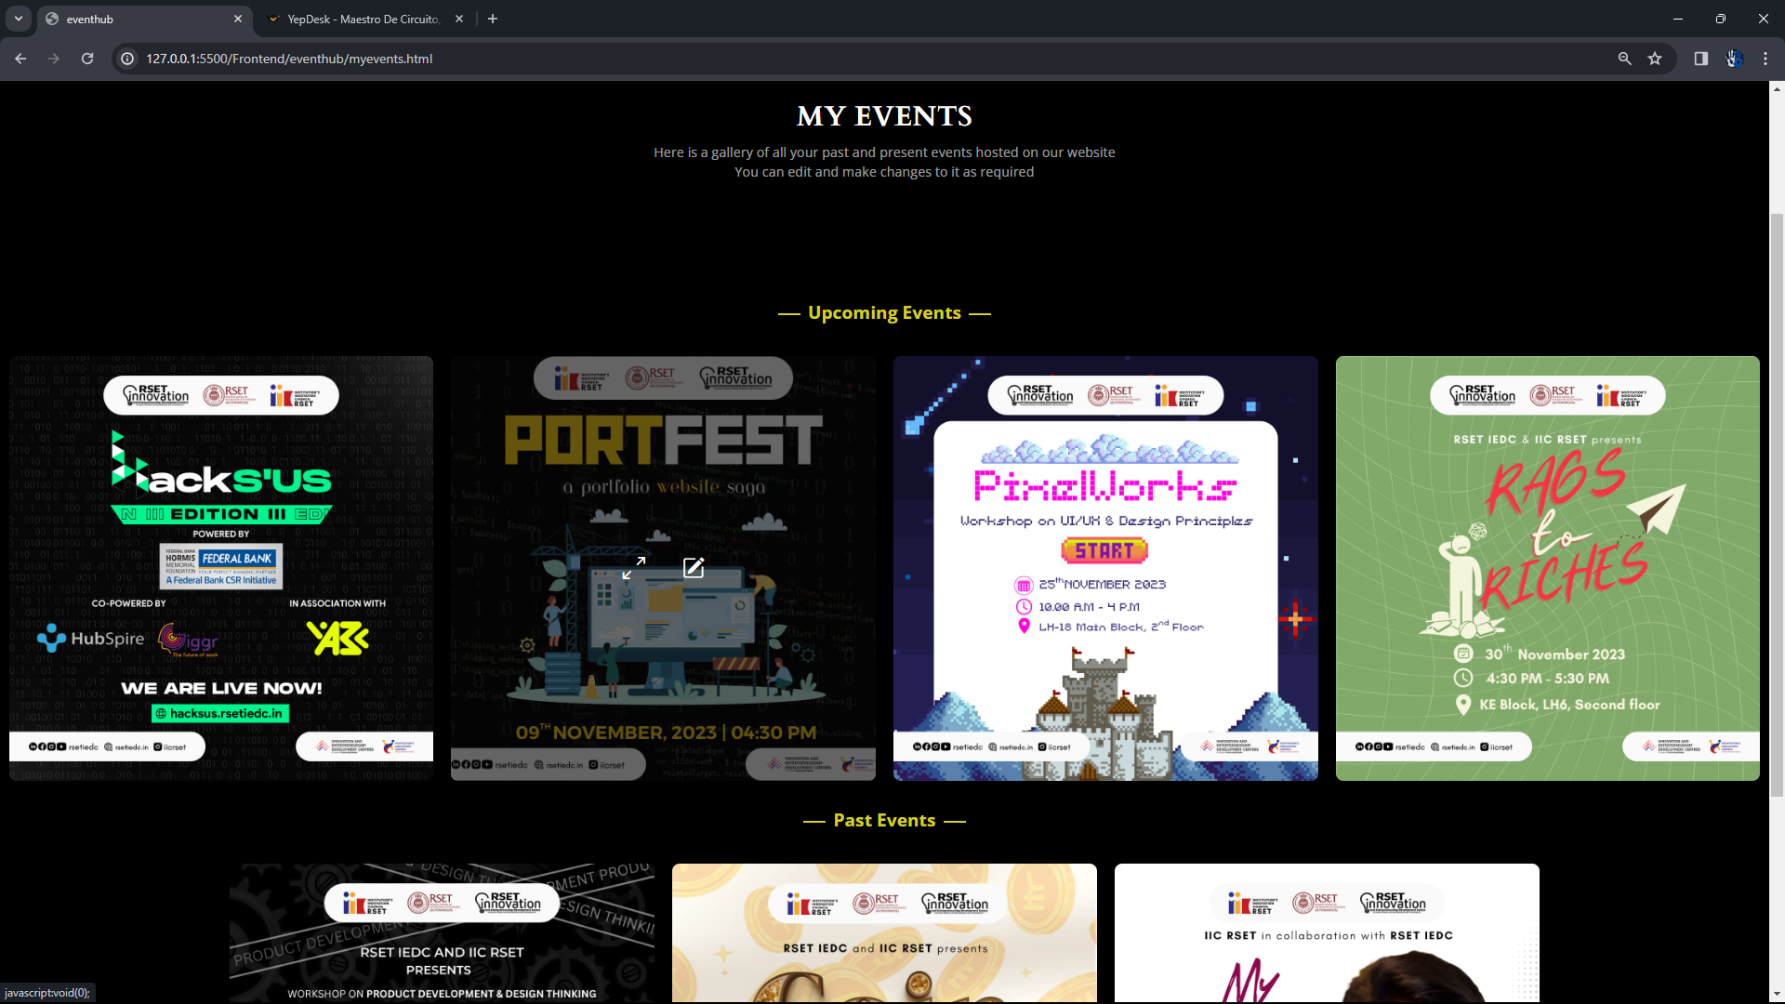
MY EVENTS

Slide 60
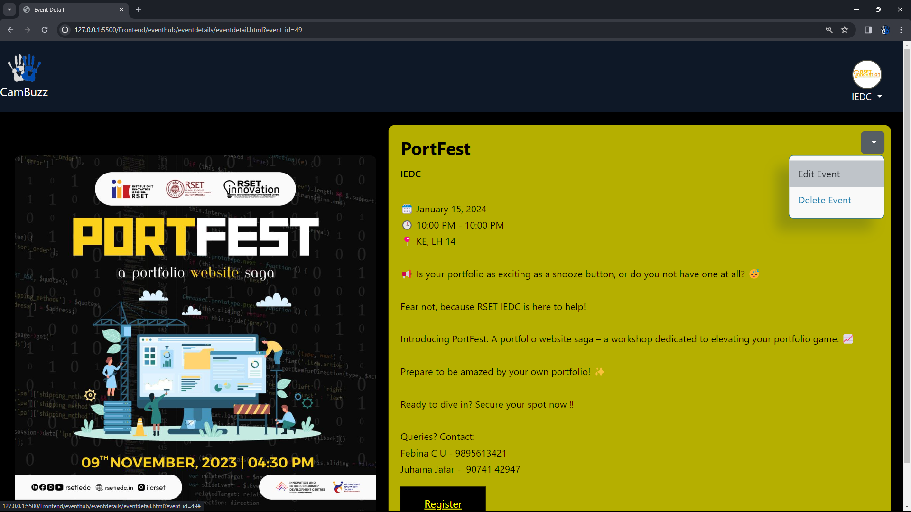
MY EVENTS DETAILS

Slide 61
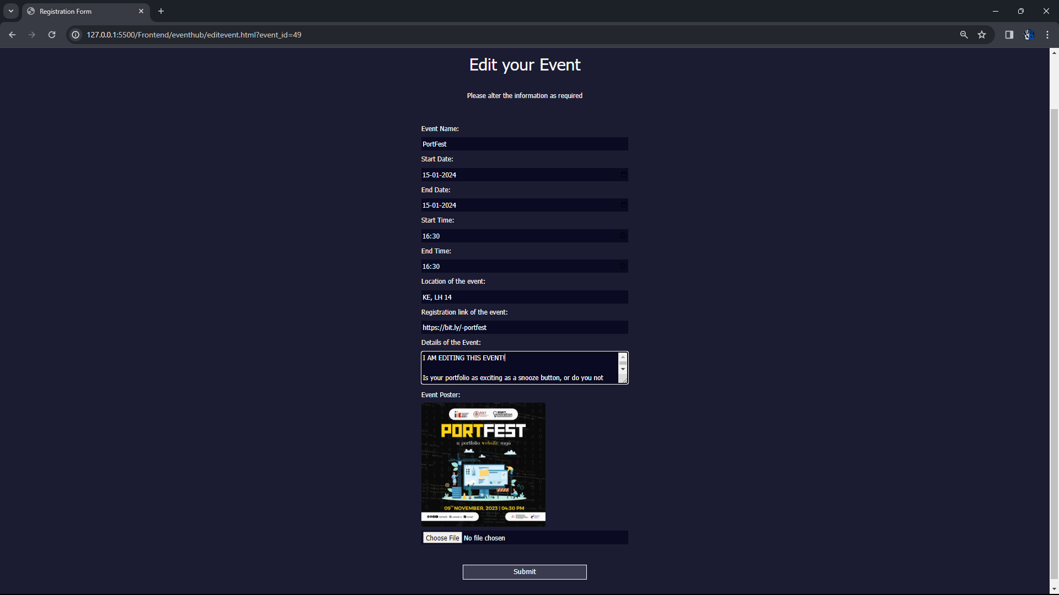
EDIT EVENT

Slide 62
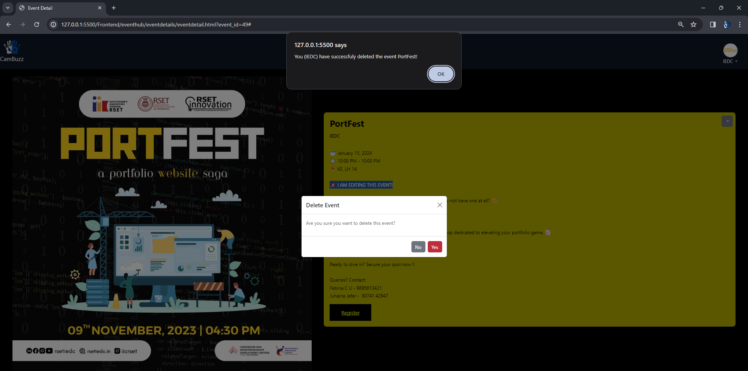
DELETE EVENT

Slide 63
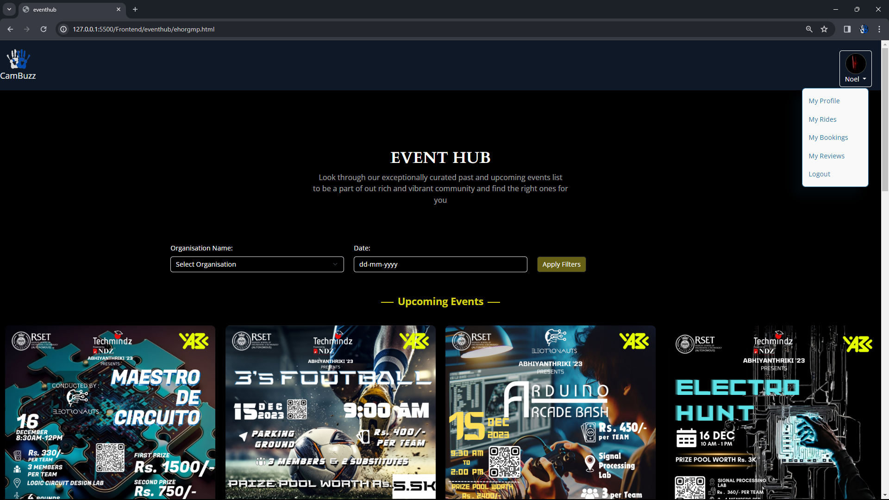
EVENT GALLERY(STUDENT)

Slide 64
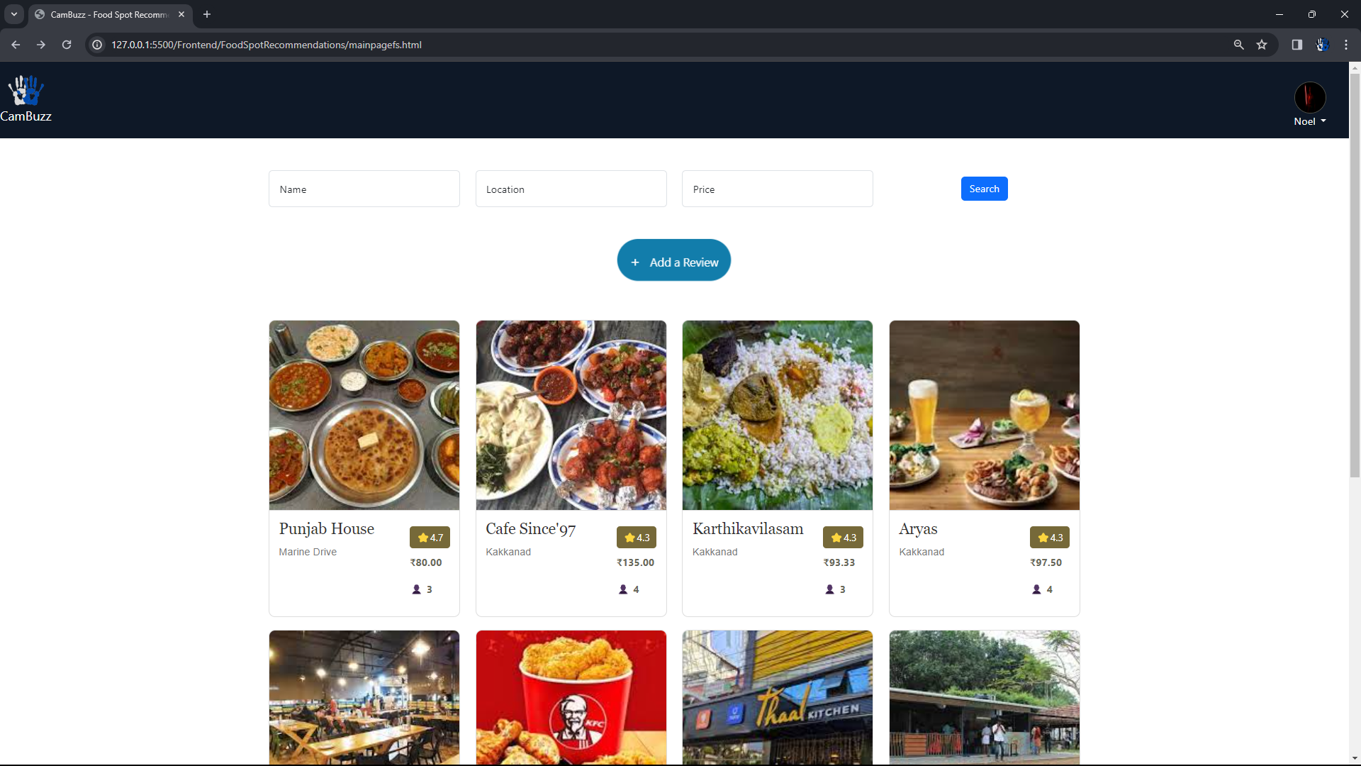
FOOD RECOMMENDATIONS MAIN PAGE/ SEARCH AND FILTER RESTAURANTS

Slide 65
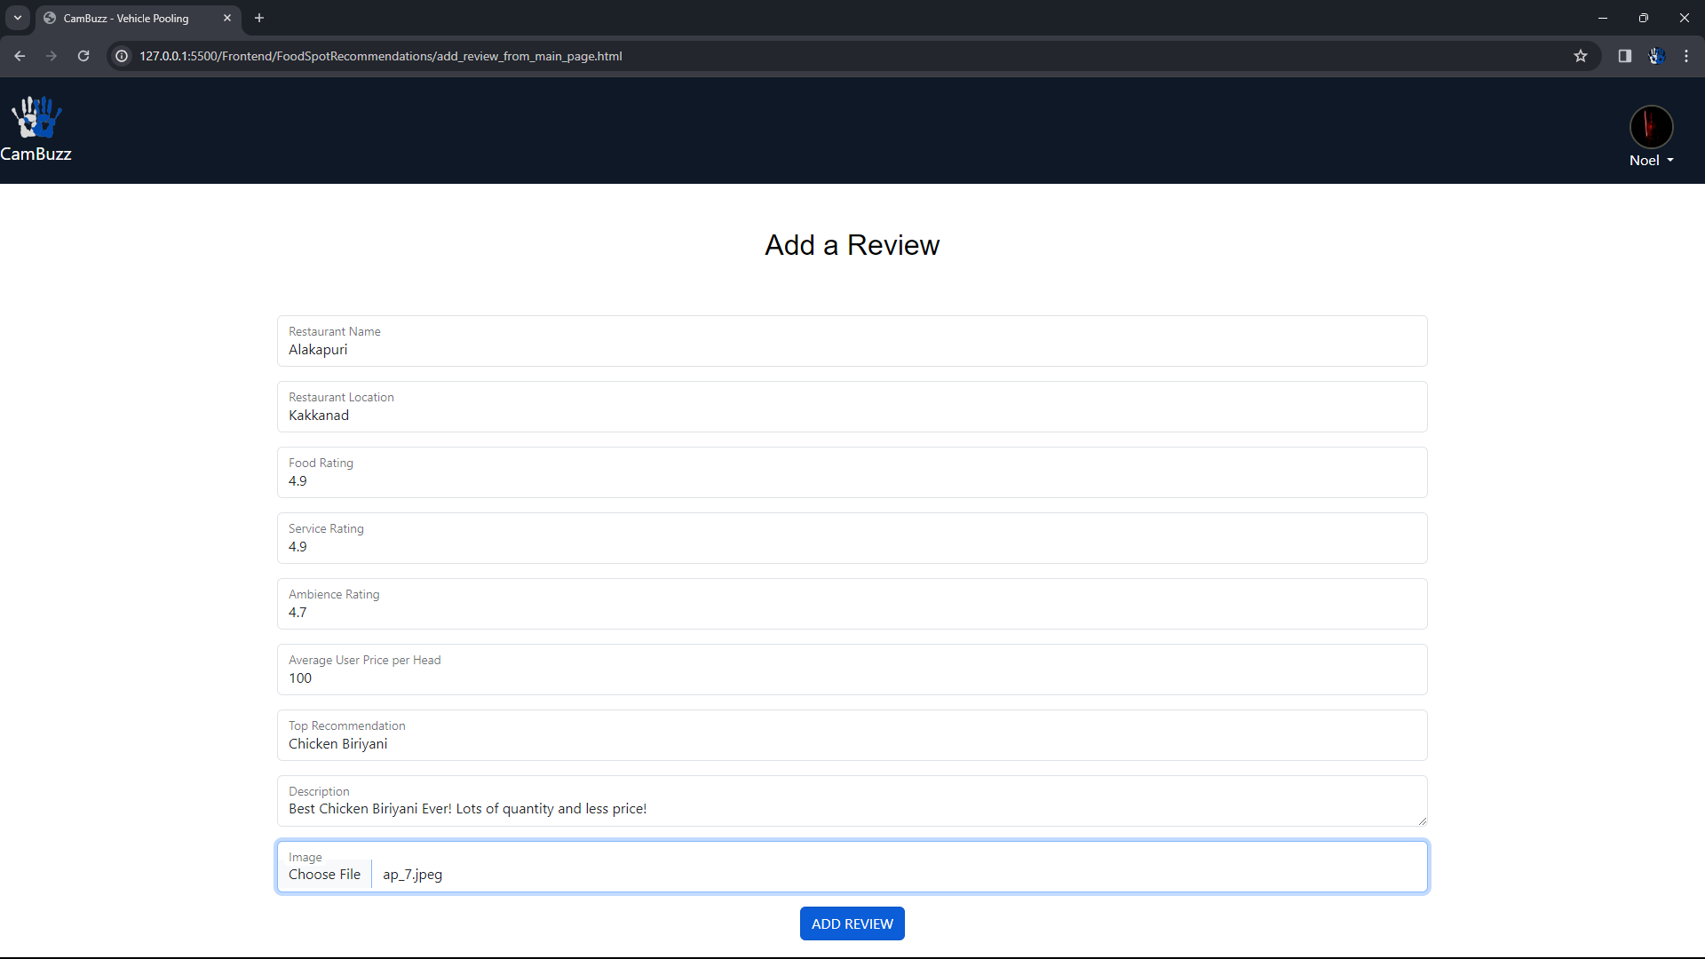
ADD REVIEW FROM MAIN PAGE

Slide 66
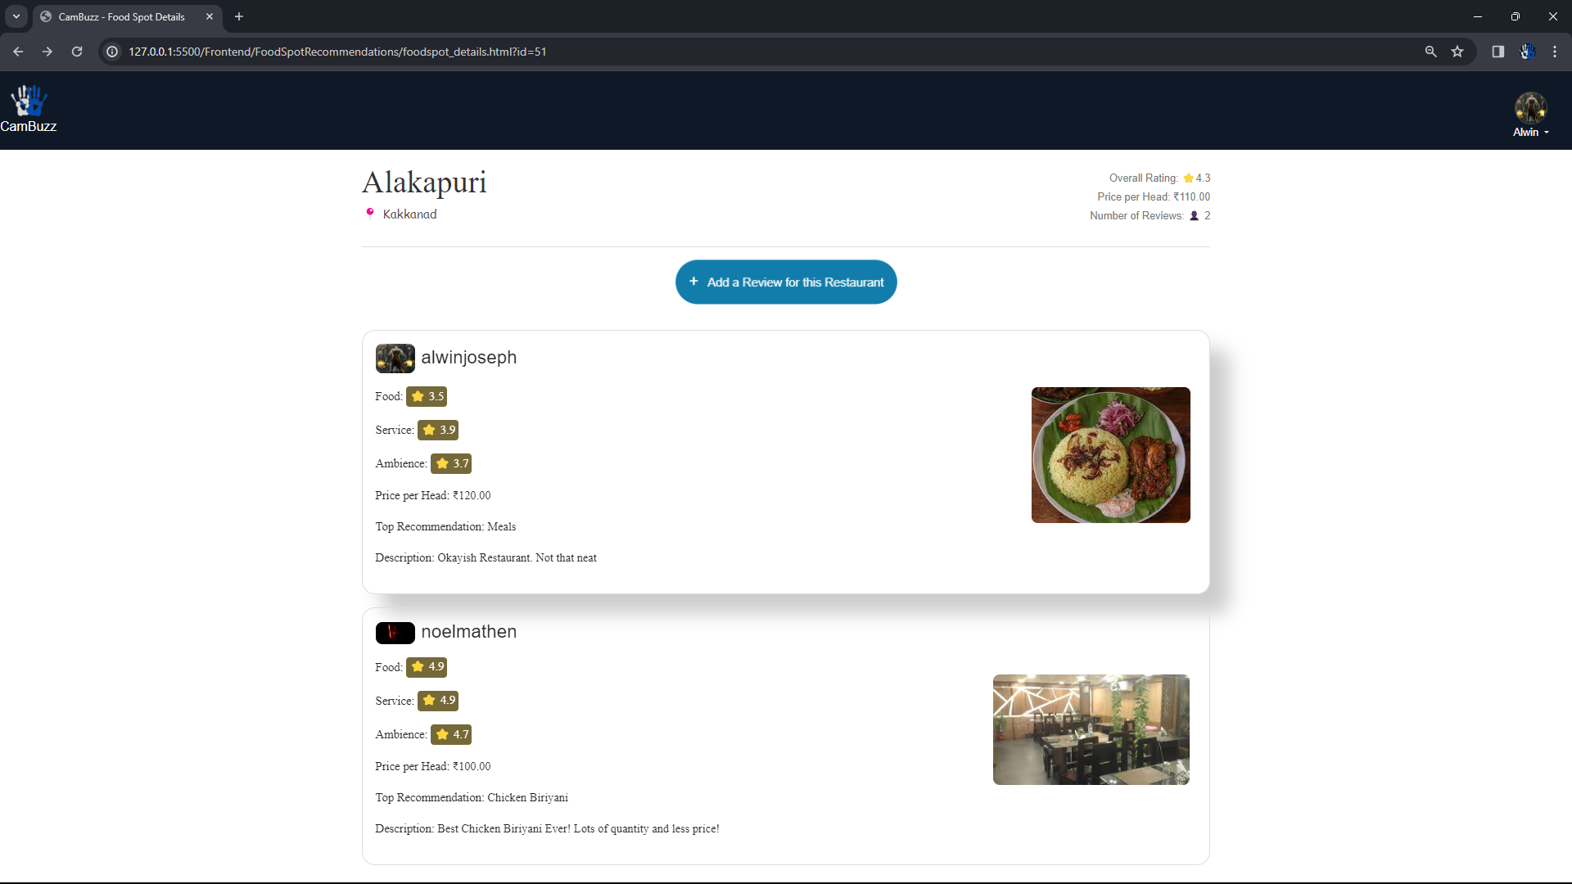
RESTAURANT DETAILS AND REVIEWS

Slide 67
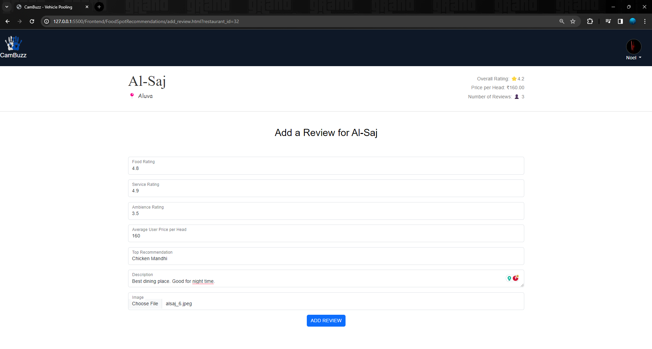
ADD REVIEW FROM RESTAURANT PAGE

Slide 68

YOUR REVIEW PAGE

Slide 69

EDIT REVIEW

Slide 70

STUDENT PROFILE

Slide 71

ORGANISATION PROFILE

Slide 72

ADMIN LOGIN

Slide 73

ADMIN PANEL

Slide 74
THANK YOU!

